Slide 1
Adoptive cell therapy(ACT) using tumor infiltrating Tcells(TILs) Madi Lab Department of Pathology, School of Medicine Tel Aviv University

Slide 2
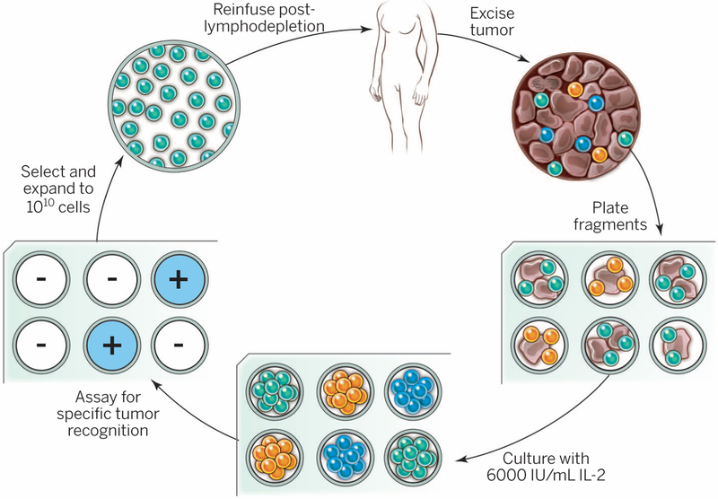
The schema as we know it
What is your schema?
Notes:
The resected melanoma specimen is digested into a single-cell suspension or divided into multiple tumor fragments that are individually grown in IL-2. Lymphocytes overgrow, destroy tumors within 2 to 3 weeks, and generate pure cultures of lymphocytes that can be tested for reactivity in coculture assays. Individual cultures are then rapidly expanded in the presence of excess irradiated feeder lymphocytes, OKT3, and IL-2. By approximately 5 to 6 weeks after resecting the tumor, up to 10¹¹ lymphocytes can be obtained for infusion into patients.
Lymphodepletion first for persistence.

Slide 3
Generation and expansion of unselected/young TIL
fragmentation, enzymatic digestion, and cell remnants technique were used to isolate TIL from surgically resected metastatic lesions.
TIL cultures were ex vivo expanded in 2 major steps:
(i) PreRapid Expansion Procedure (Pre-REP); Purified TIL cultures were established in approximately 2 weeks. Those shortterm cultured ("young") TIL were neither assayed nor selected ("unselected") on the basis of their interferongamma secretion after antigenic stimulation, as this assay was previously shown to be insufficient in predicting clinical efficacy (14, 17, 18). The obtained TIL cultures were cryopreserved or entered directly into the second step of expansion. The cut-off for an established TIL culture was defined as 80 10e6 cells, because about 50 10e6 TIL are required to initiate REP, the next expansion step, and another 30 10e6 TIL to compensate for the loss of cells during cryopreservation and thawing.
(ii) REP; approximately 50 106 unselected TIL were expanded to treatment levels in a large-scale expansion procedure using anti-CD3 antibody, rhIL-2 and irradiated feeder cells of healthy donors in gas-permeable bags (7) or GRex flasks (19). Within 14 days, cultures expanded by about 1,000 to
Clin Cancer Res Published Online First May 20, 2013. Michal J. Besser, Ronnie Shapira-Frommer, Orit Itzhaki, et al. and Efficacy after Failure to Prior Immunotherapies Patients with Metastatic Melanoma: Intent-to-Treat Analysis Adoptive Transfer of Tumor-Infiltrating Lymphocytes in

Slide 4
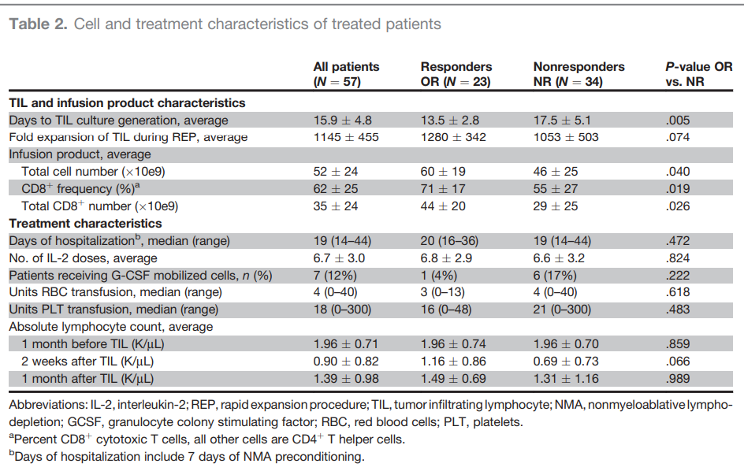
Predictor variables
Notes:
Do you have this information?

Slide 5
Our data
4 responders & 4 non responders from Ella institute
Melanoma
History of immunotherapy – No
Site of TIL harvest ?

Slide 6
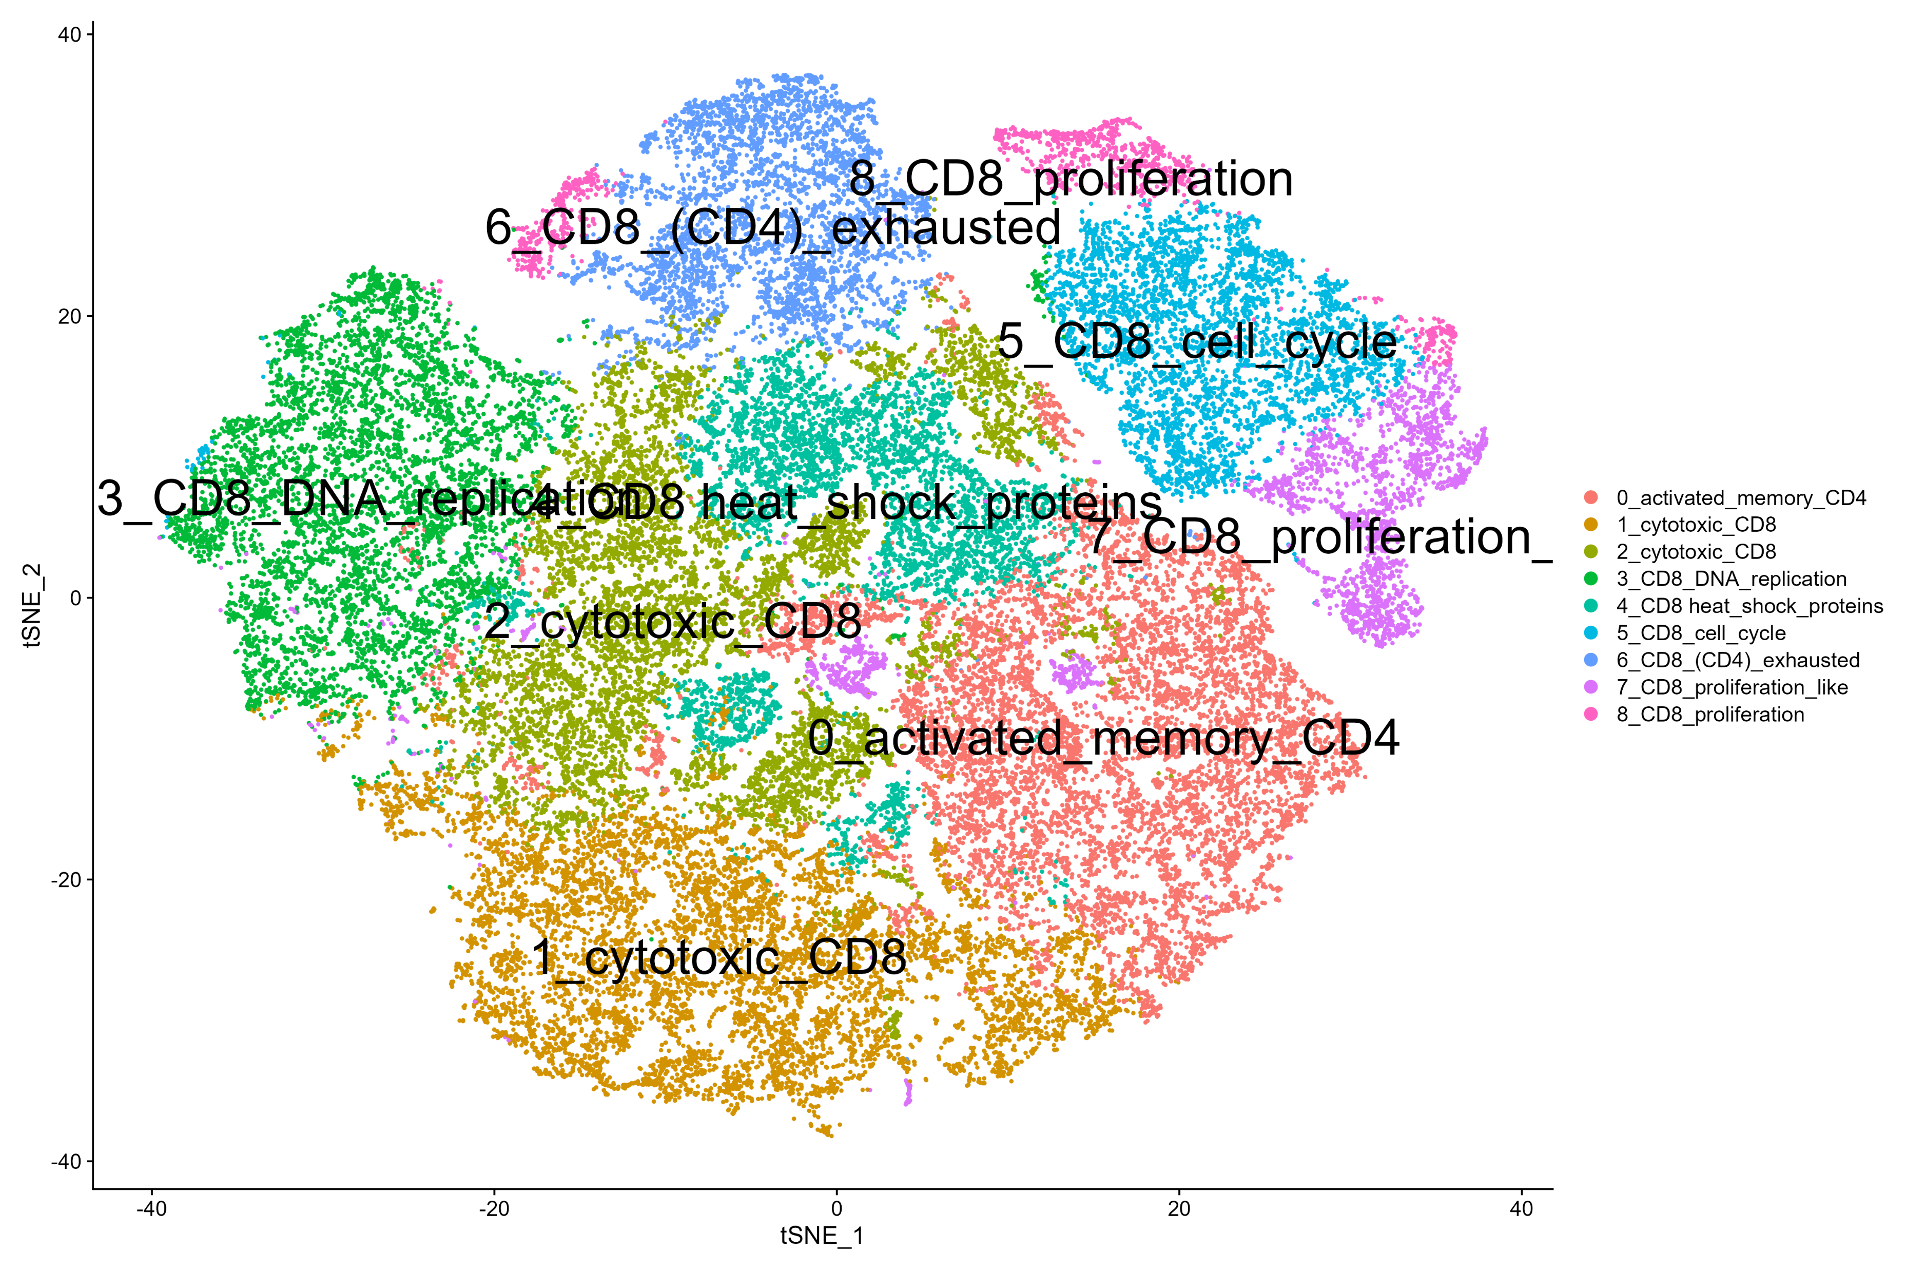
tSNE

Slide 7
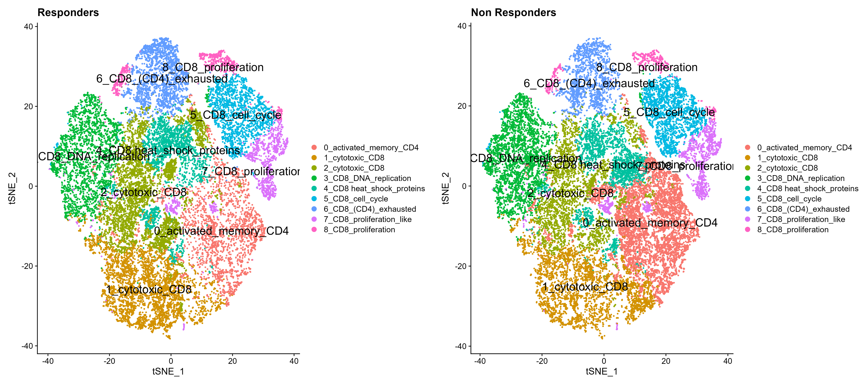
tSNE by response

Slide 8
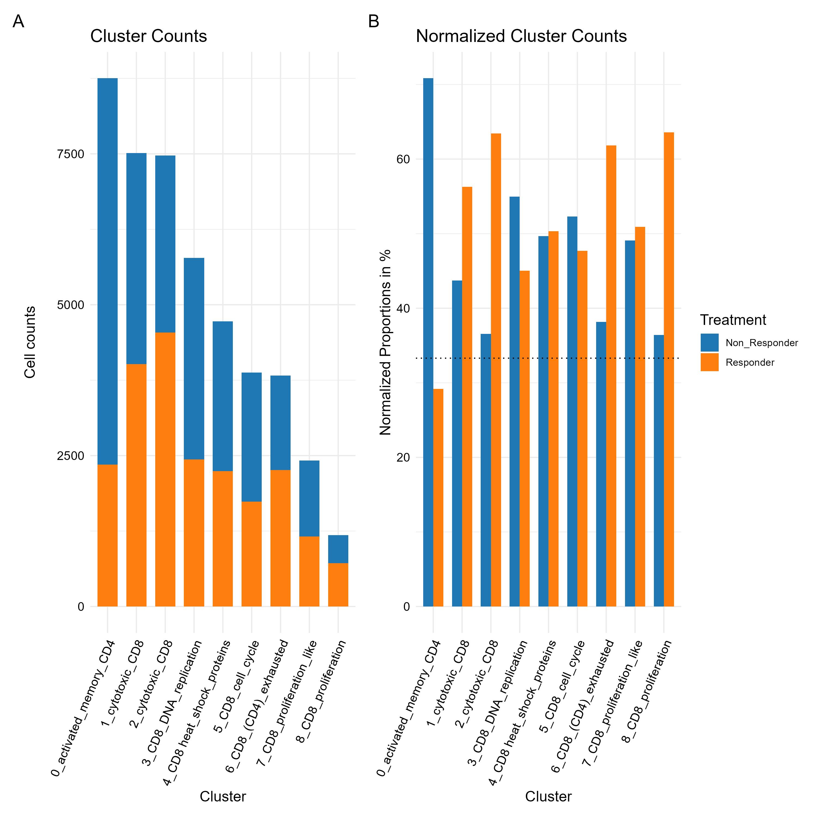
All cells unnormalized + normalized contribution of each sample to each cluster

Slide 9
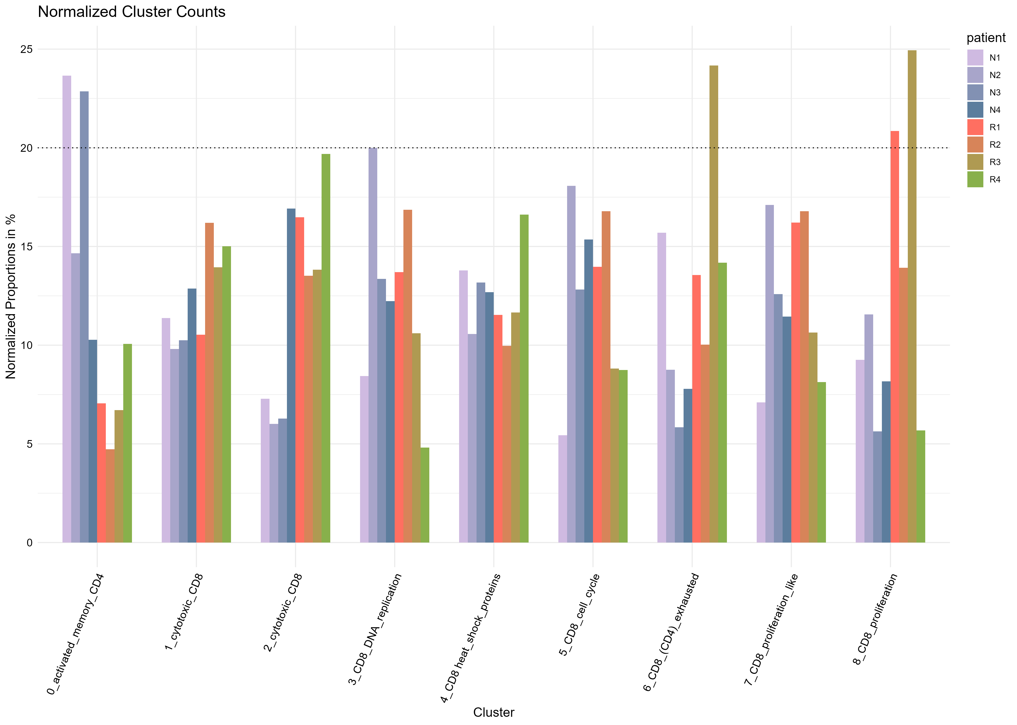
contribution per patient

Slide 10
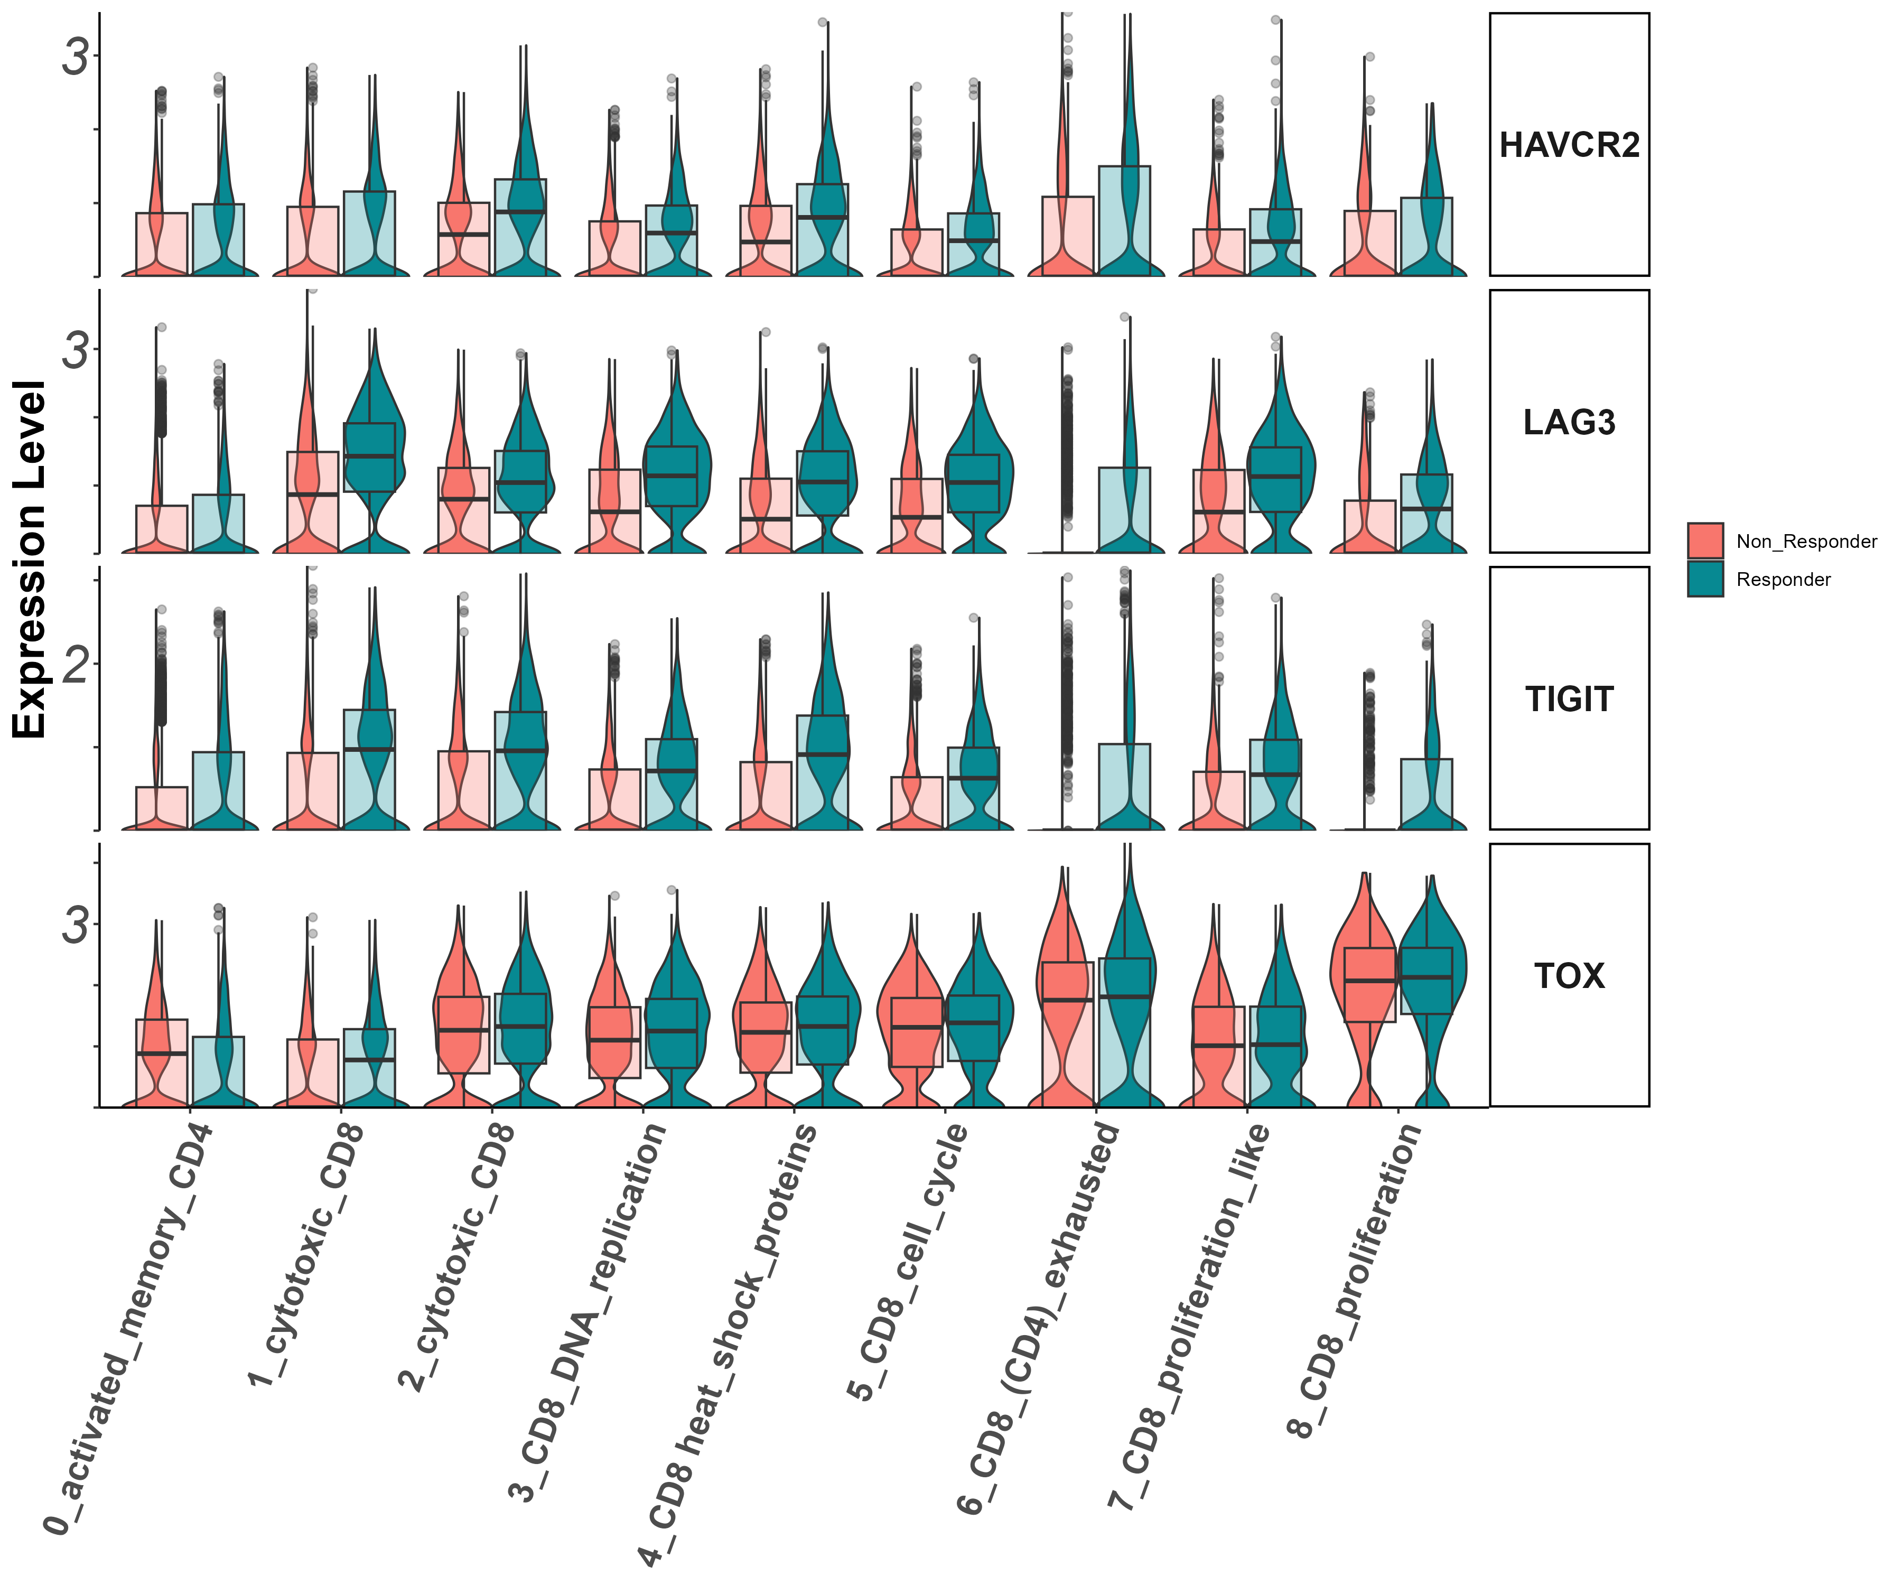
activation/exhaustion markers Tigit, Lag3, Havcr2, Tox (vln)

Slide 11
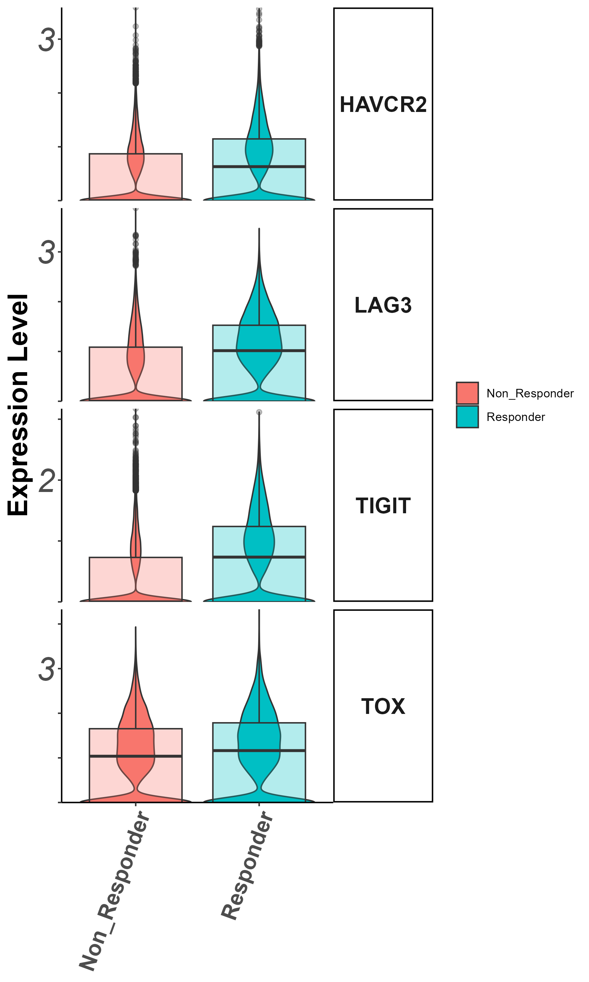
exhaustion markers Tigit, Lag3, Havcr2, Tox
(groupby_treatment)

Slide 12
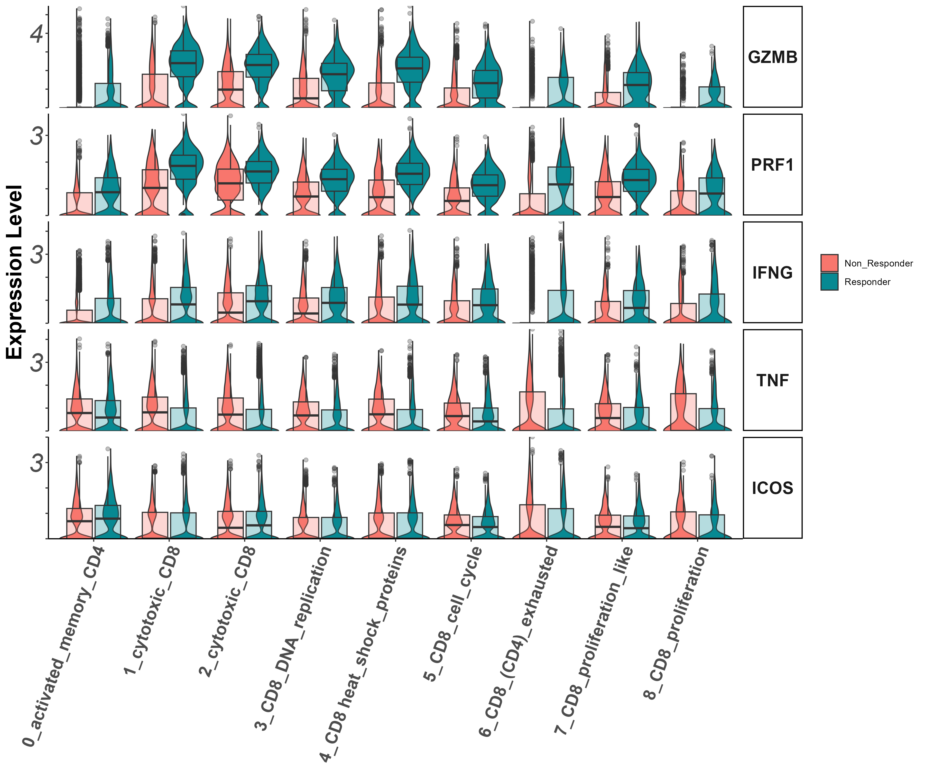
Effector markers
Gzmb, Prf1, Ifng, Il7r (vln)

Slide 13
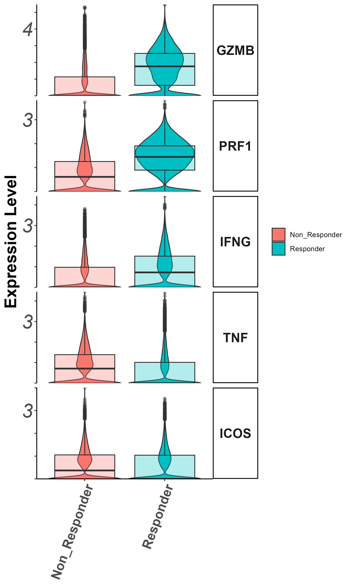
Effector markers
Gzmb, Prf1, Ifng, Tnf, Icos (groupby_treatment)

Slide 14
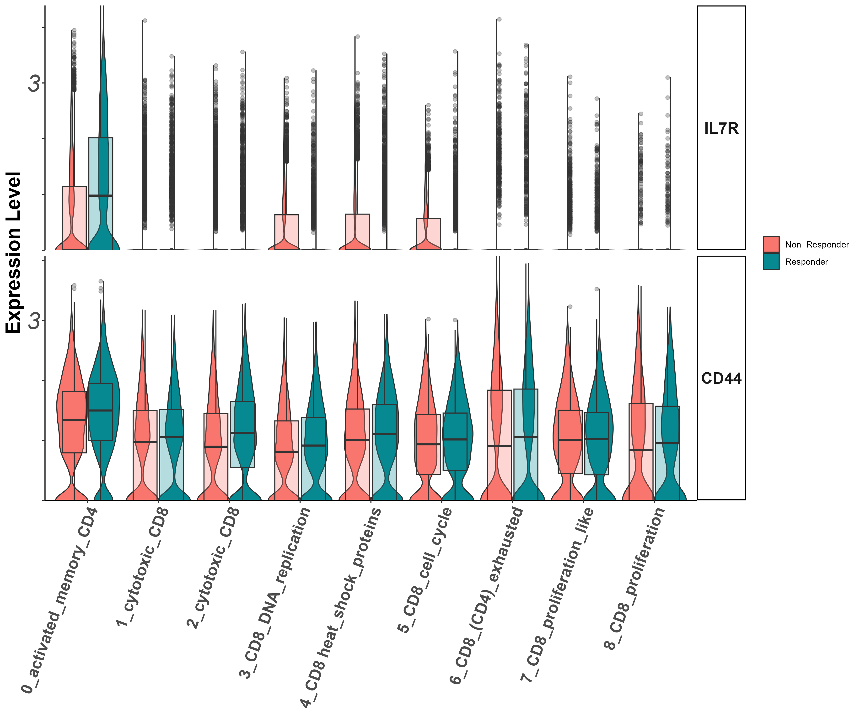
Stem/persister/naïve markers
Il7r, CD44
(vln)

Slide 15
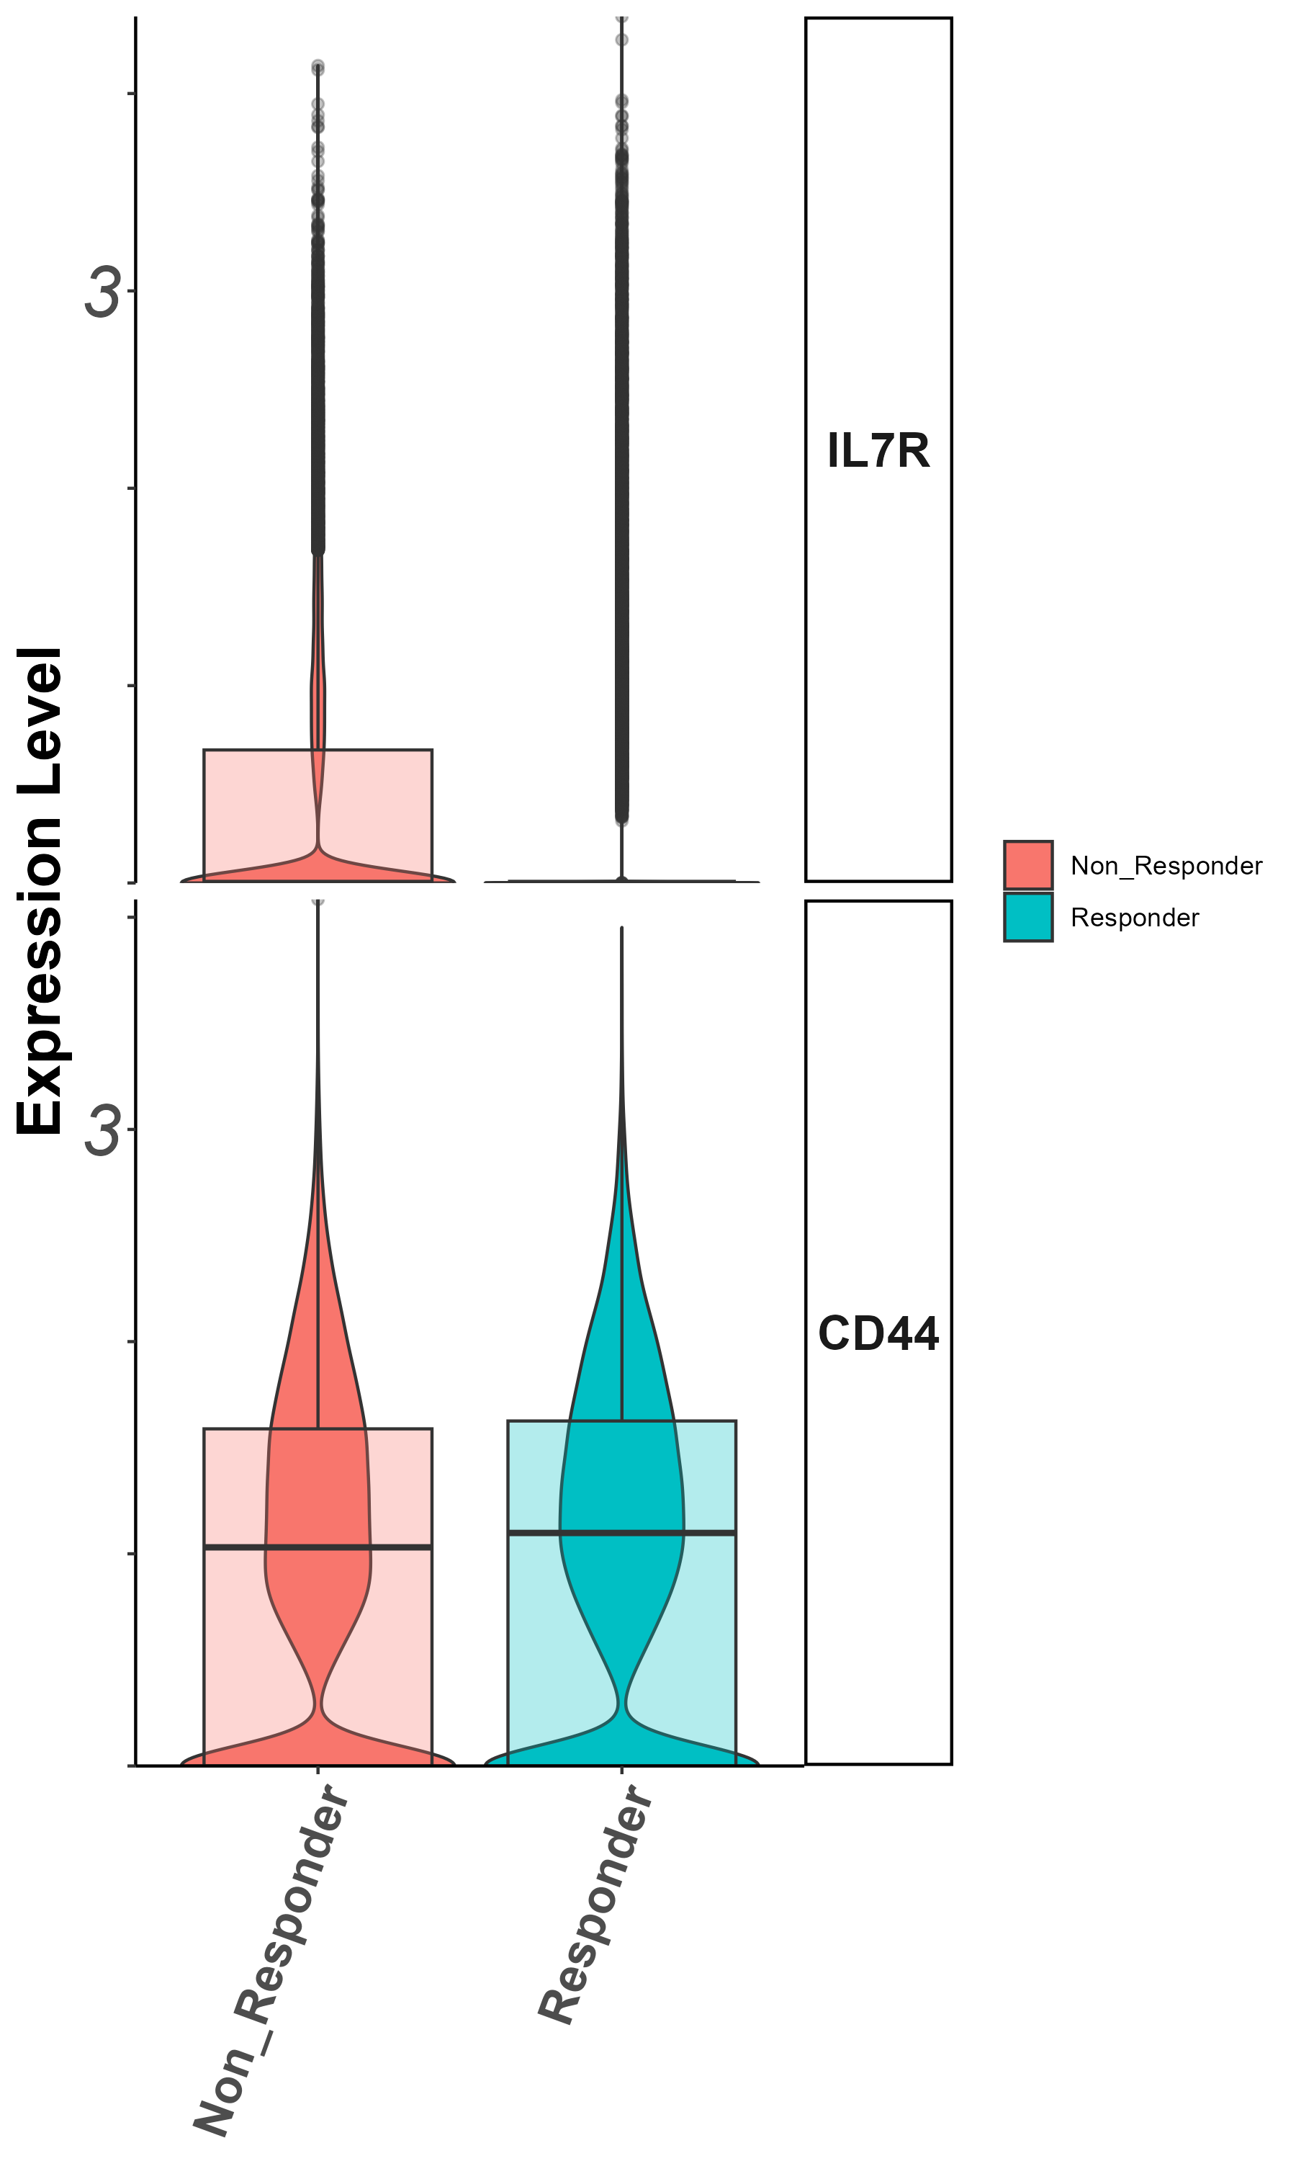
Stem/persister/naïve markers
Il7r, CD44
(groupby_treatment)

Slide 16
Summary – all cells
Patients are coherent in response groups in large clusters.
Non responders show lower CD8/CD4 ratio.
Higher expression of activation and effector markers in responders vs. non-responders.

Slide 17
Cluster 0 (CD4/non responders) zoom in analysis
Notes:
להוסיף ריבוע מדגיש לקלאסטר אפס

Slide 18
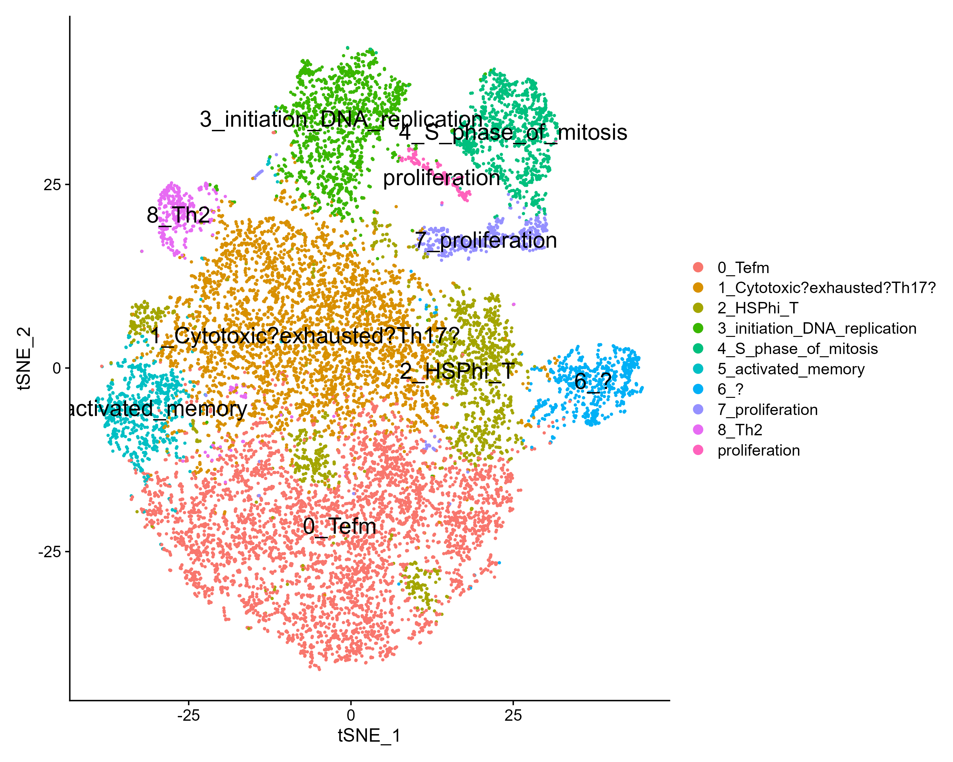
tSNE

Slide 19
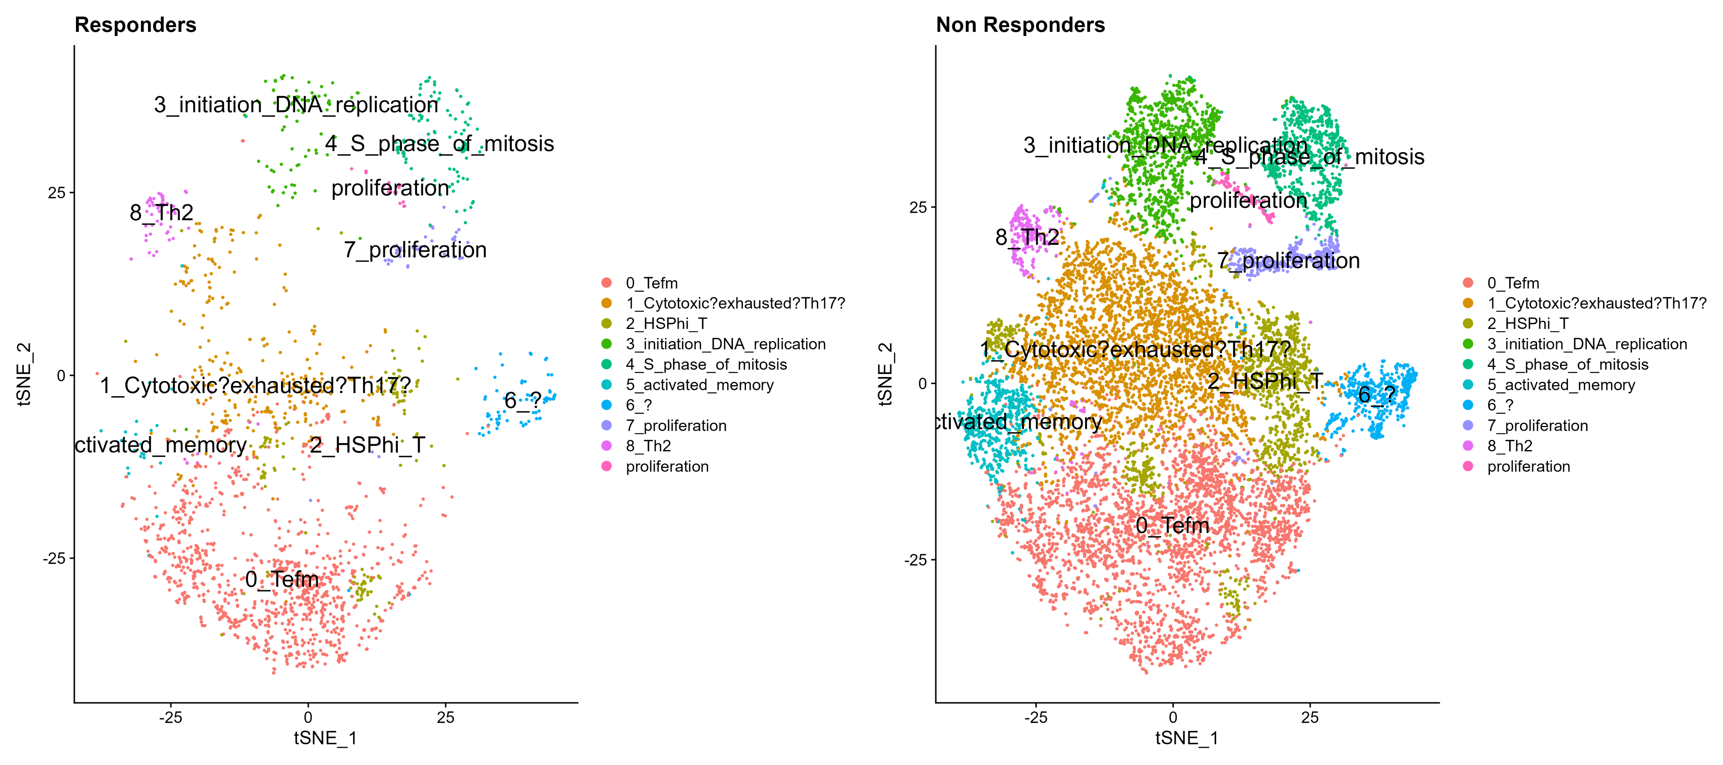
tSNE by response

Slide 20
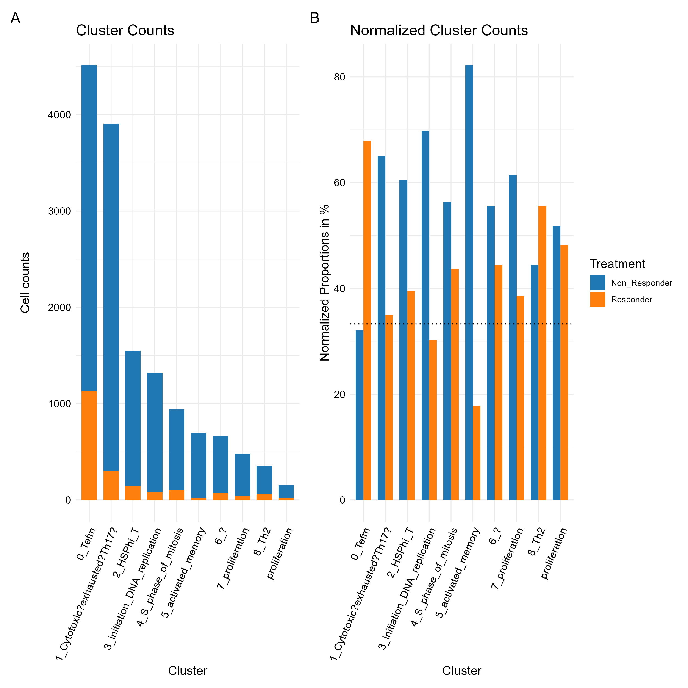
Cluster 0 zoom in analysis contribution per response

Slide 21
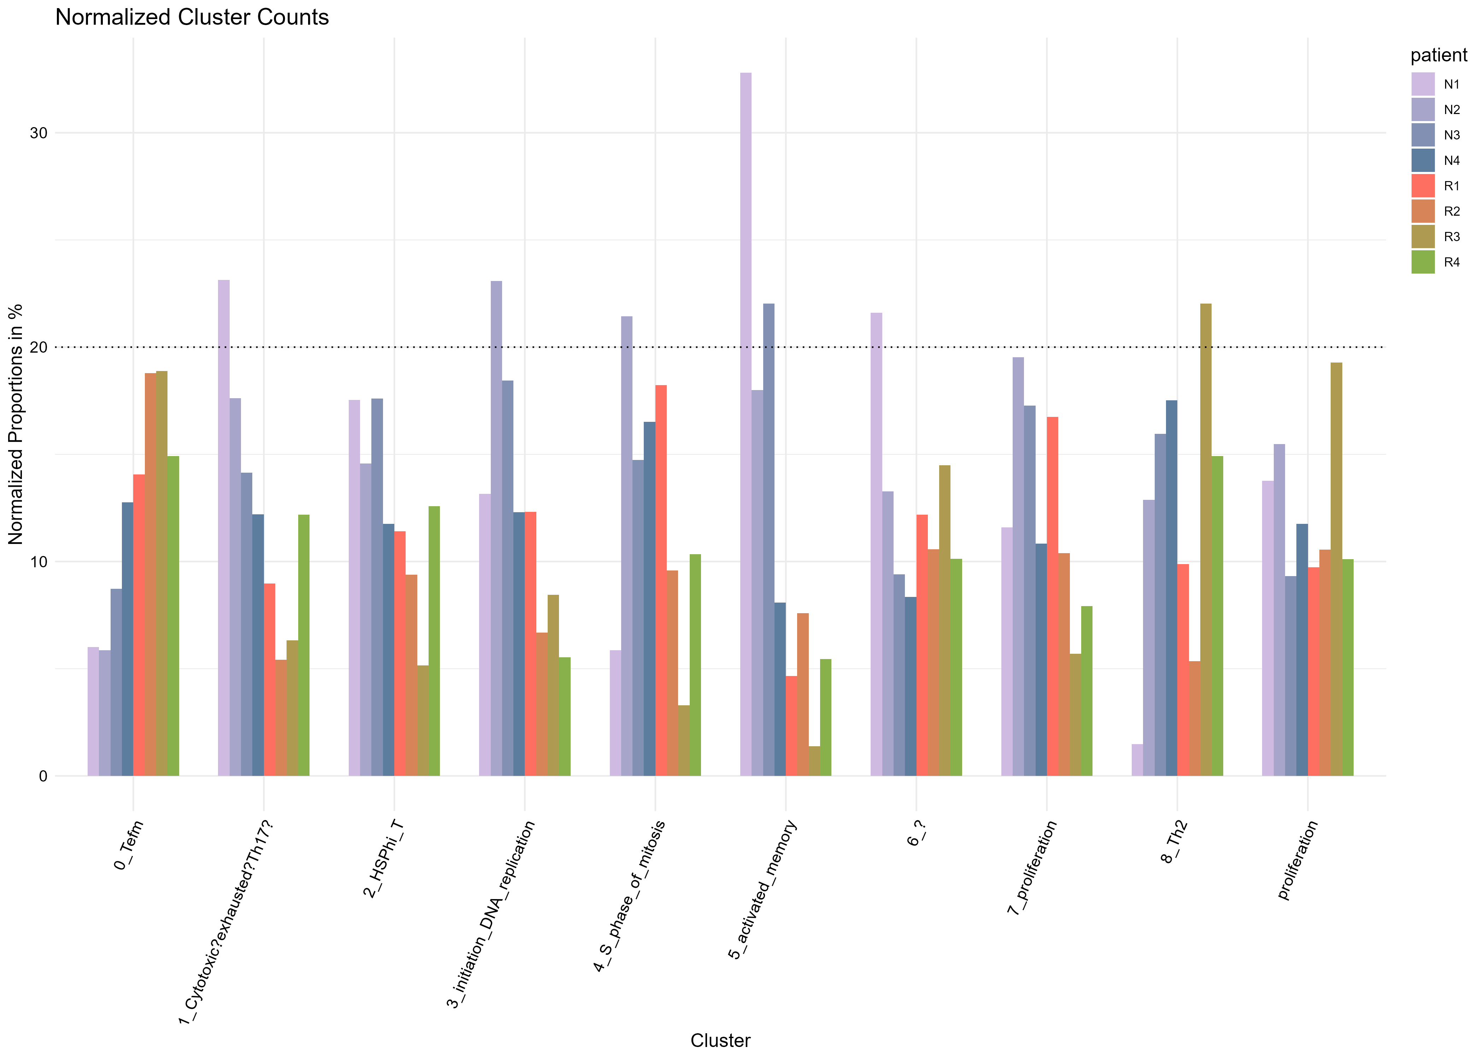
contribution per patient

Slide 22
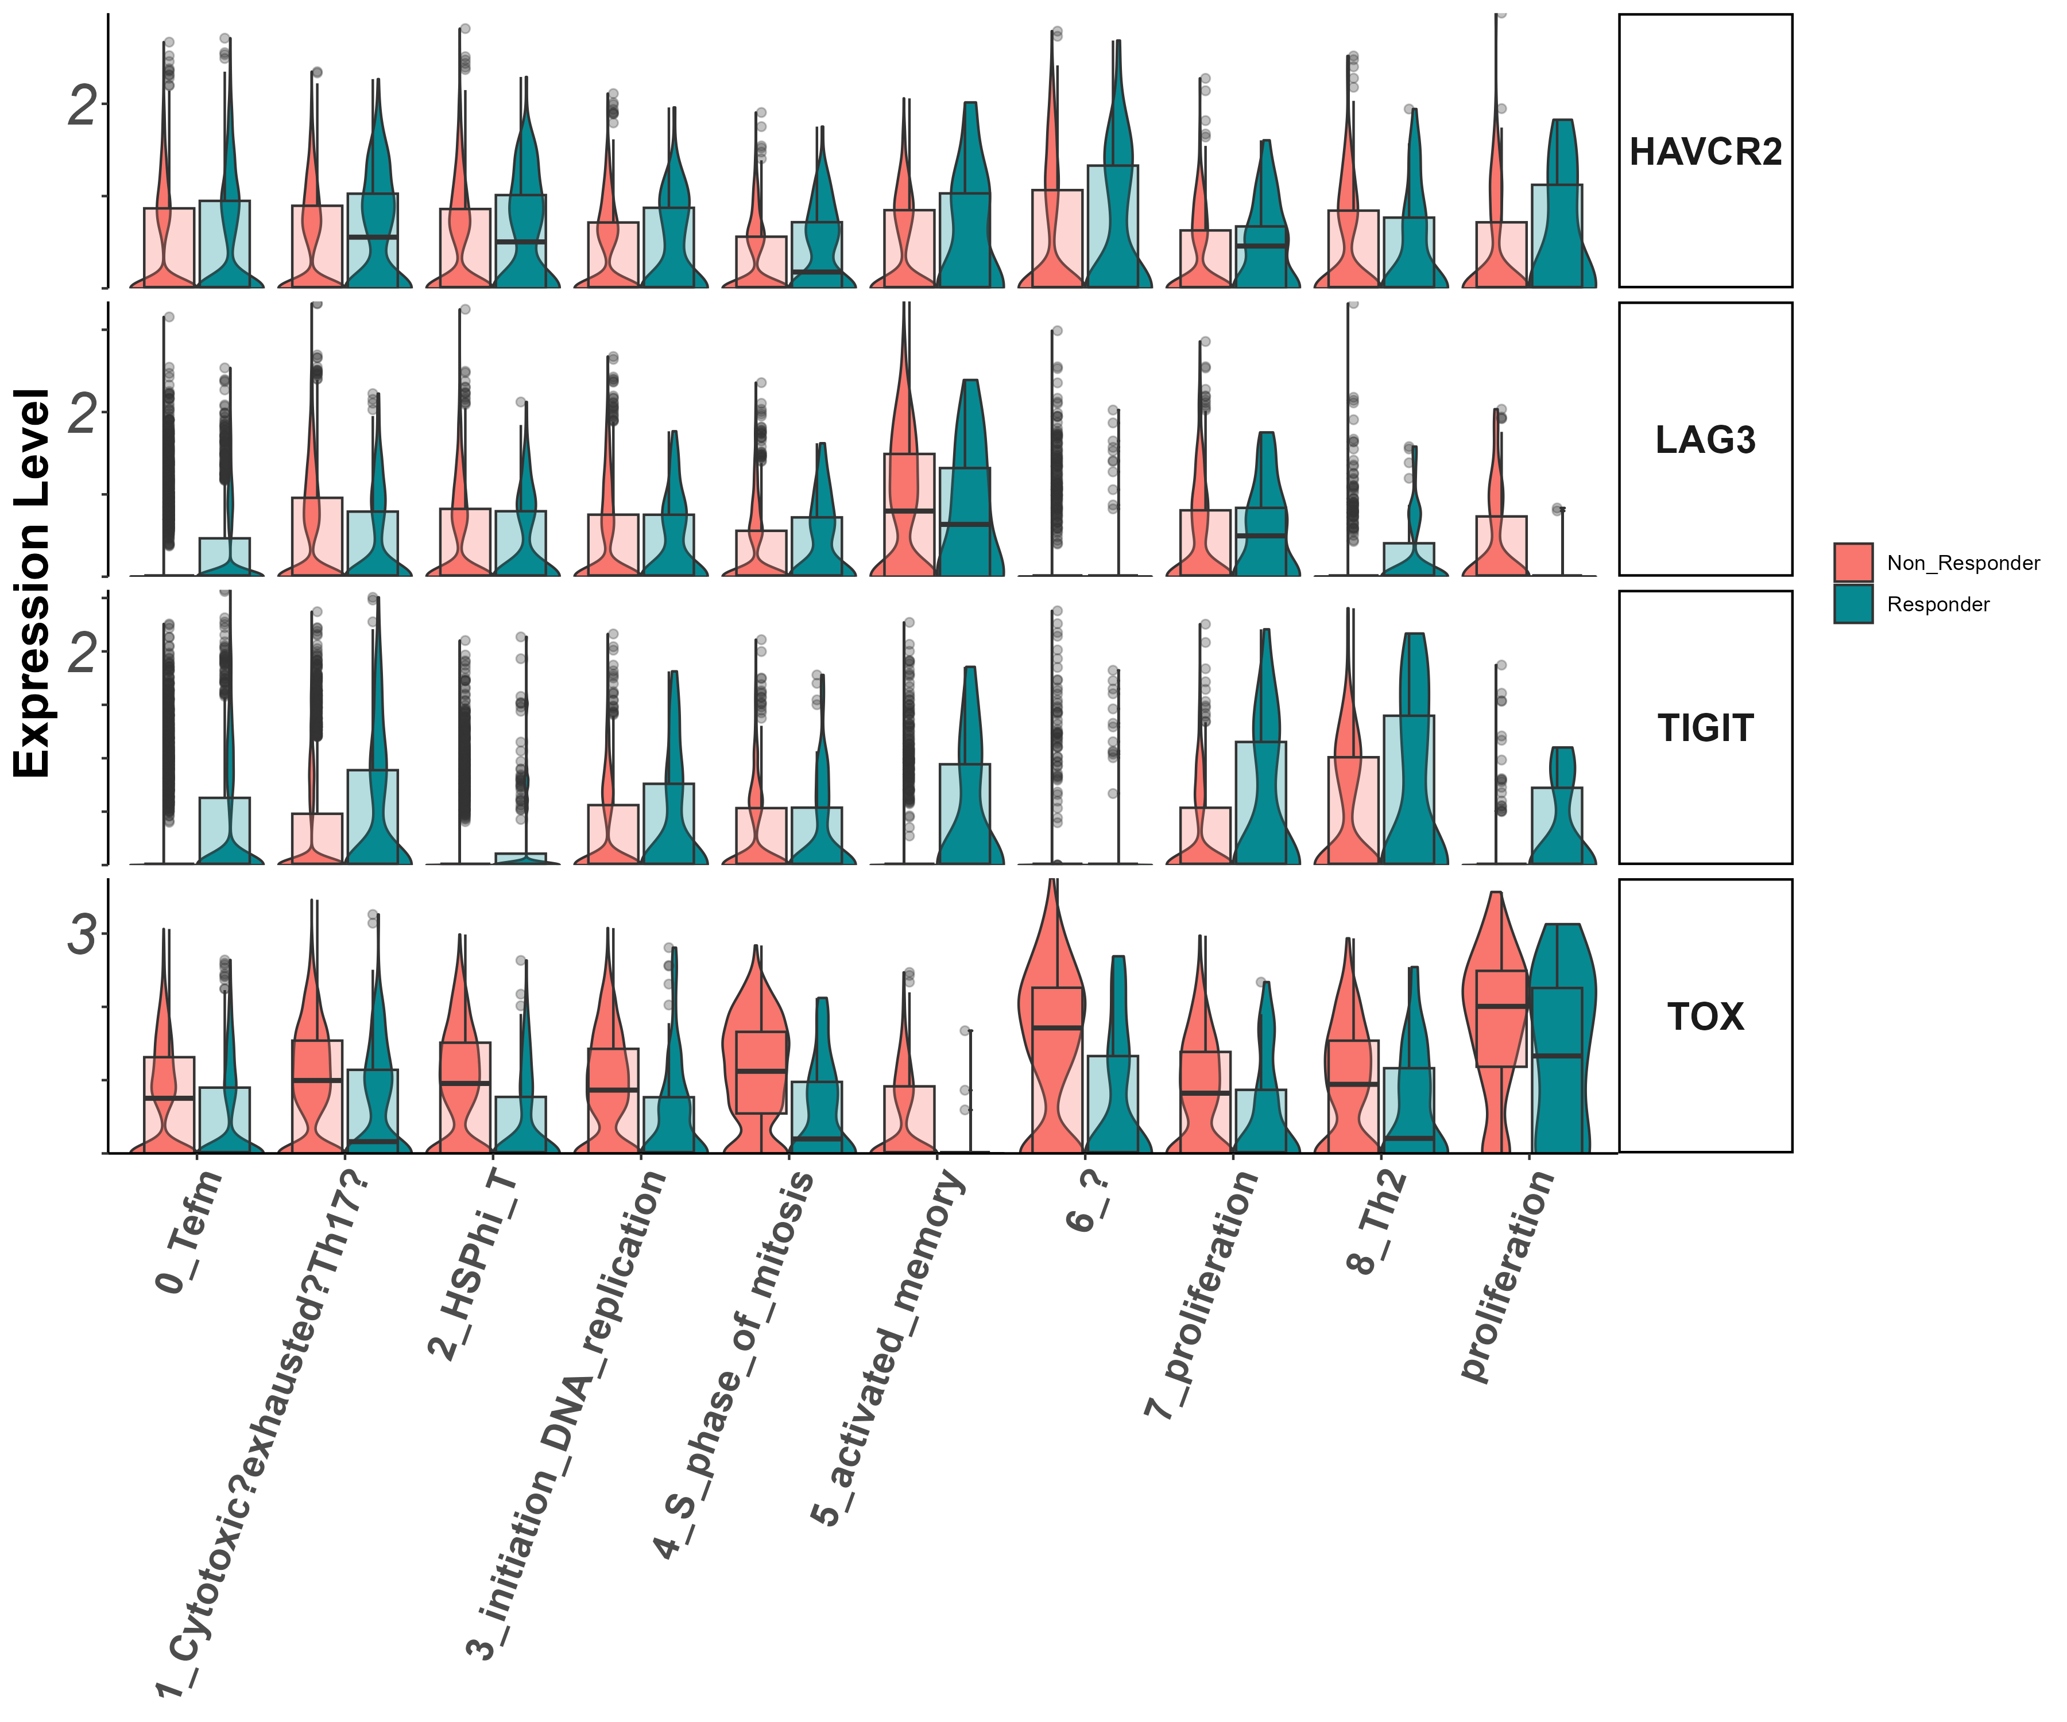
activation/exhaustion markers Tigit, Lag3, Havcr2, Tox (vln)

Slide 23
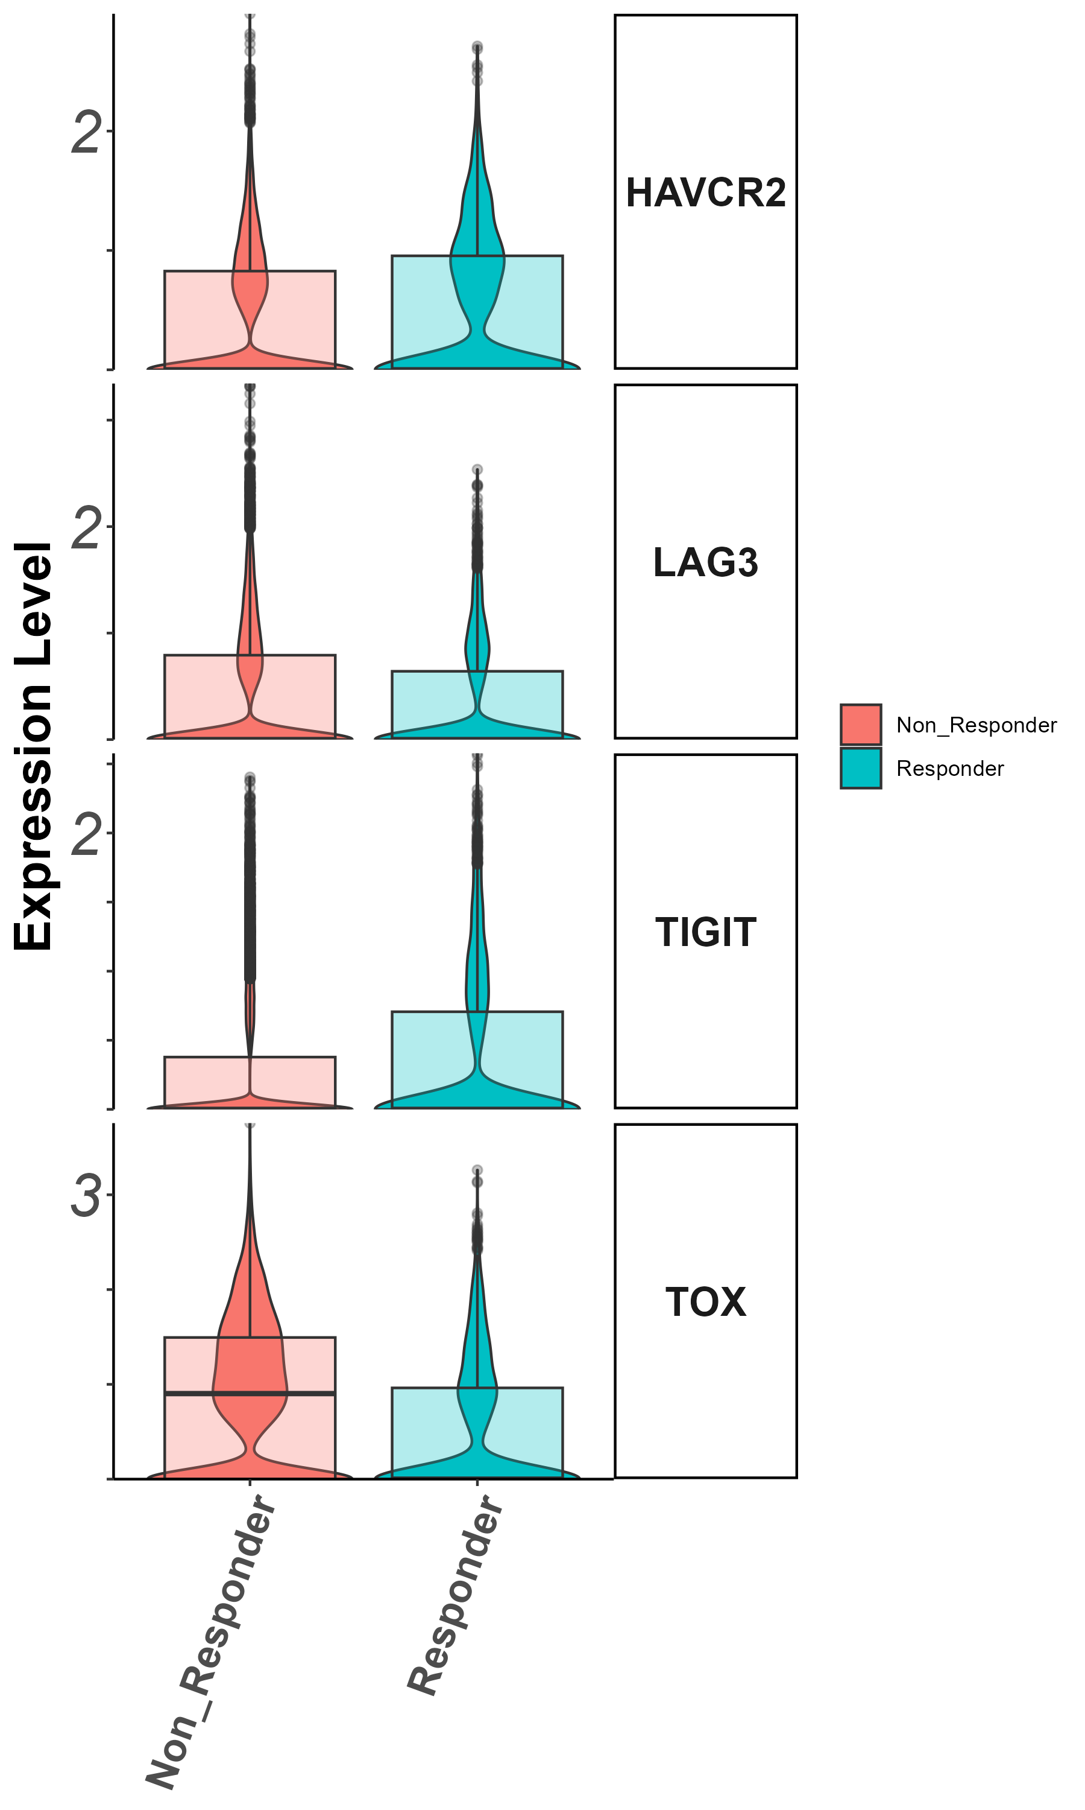
activation/exhaustion markers Tigit, Lag3, Havcr2, Tox
(groupby_treatment)

Slide 24
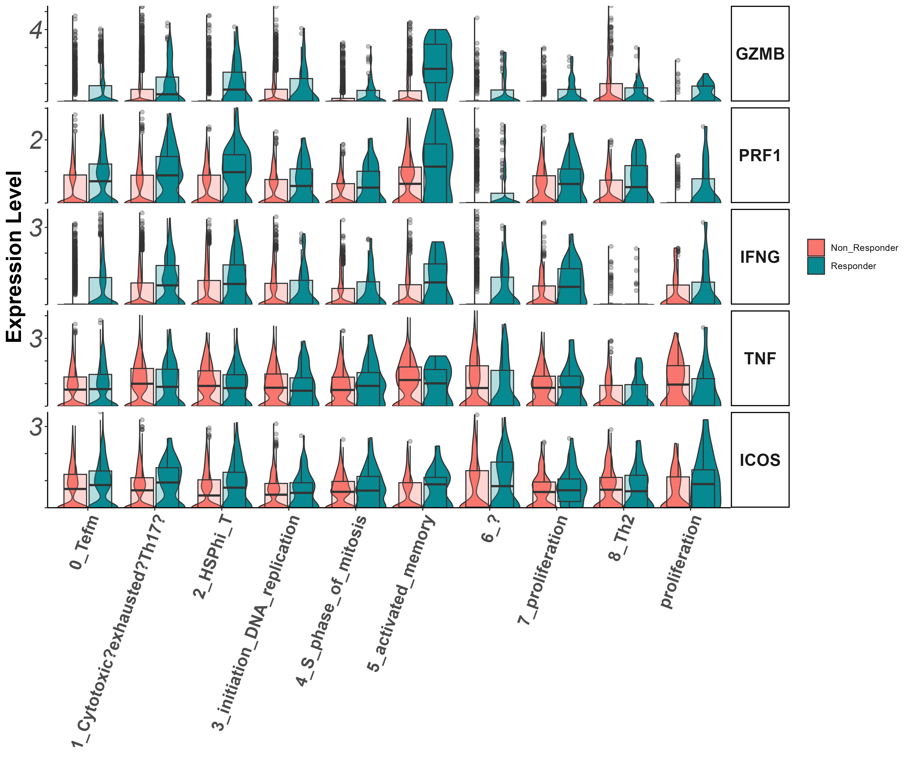
Effector markers
Gzmb, Prf1, Ifng, Tnf, Icos
(vln)

Slide 25
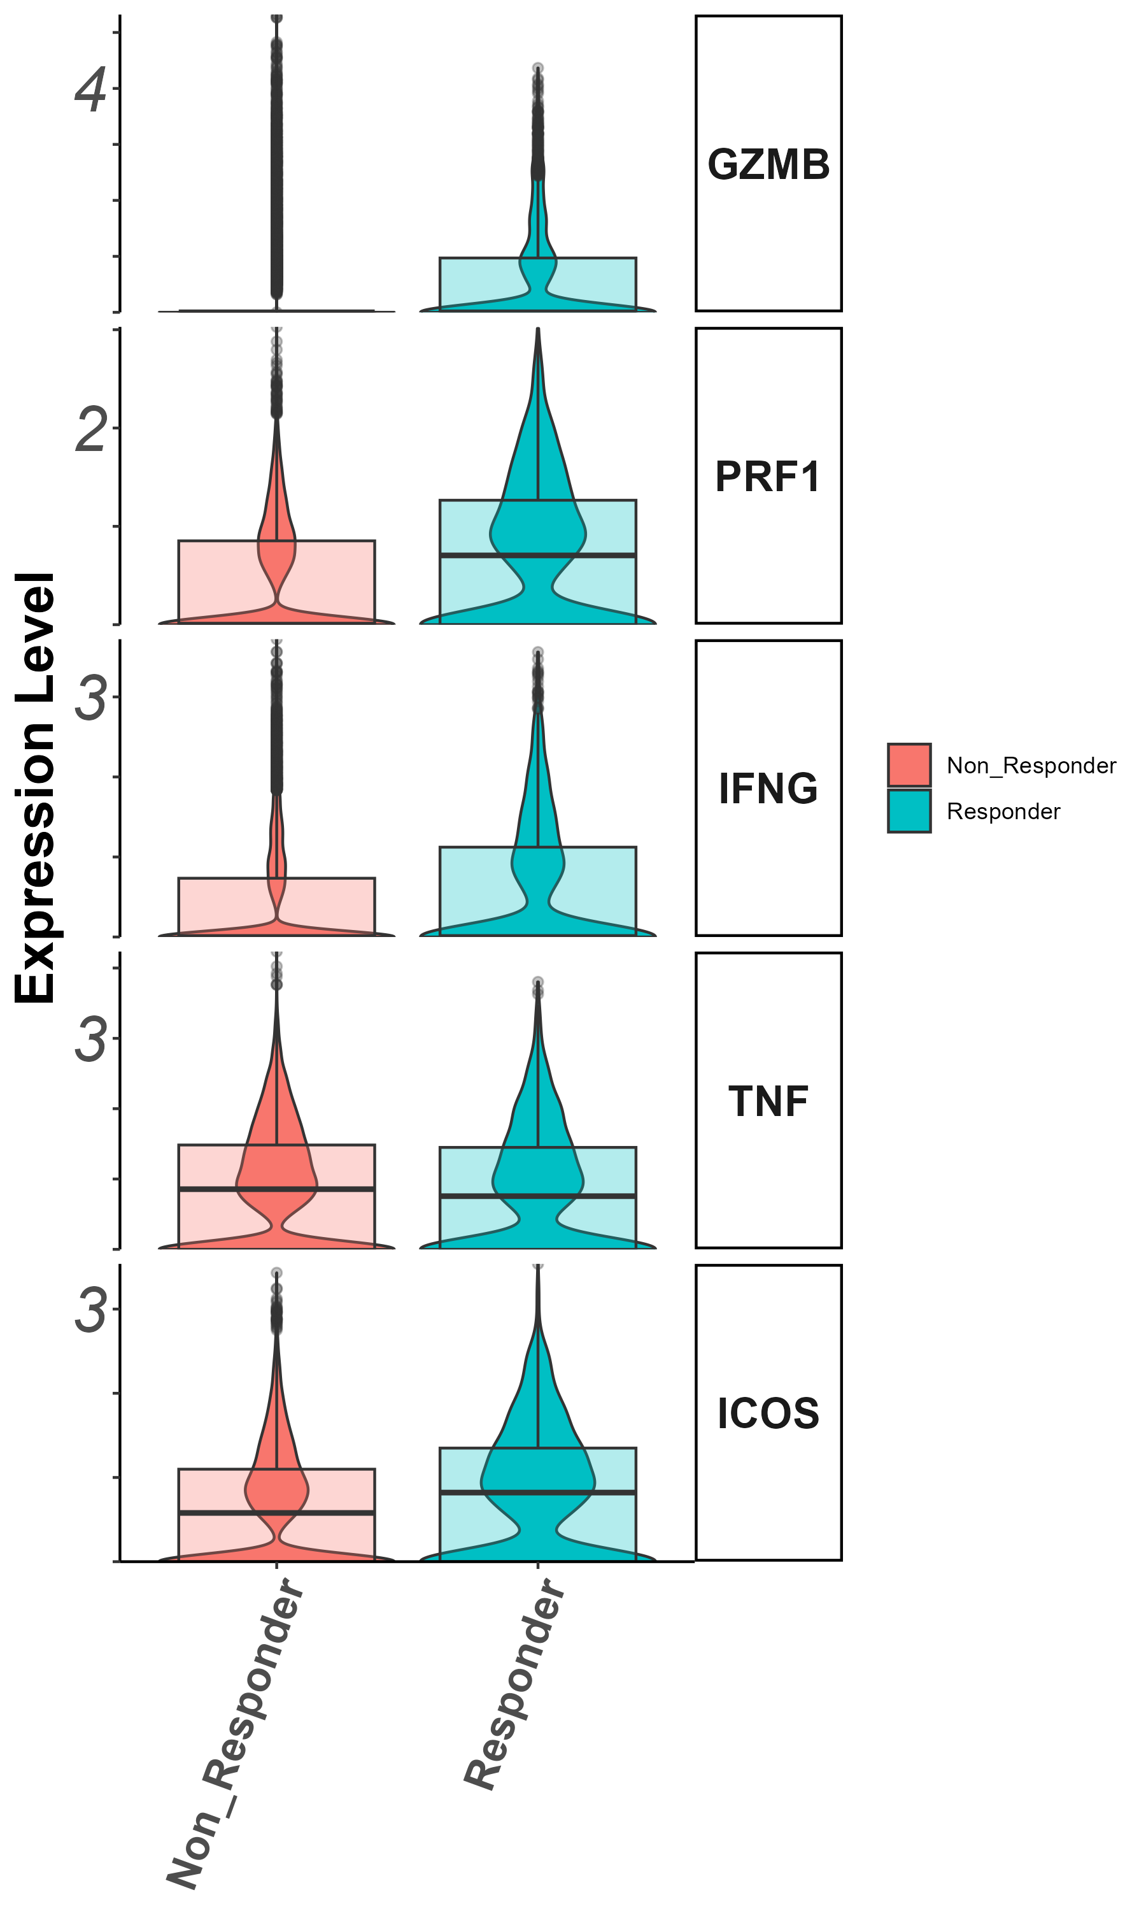
Effector markers
Gzmb, Prf1, Ifng, Il7r (groupby_treatment)

Slide 26
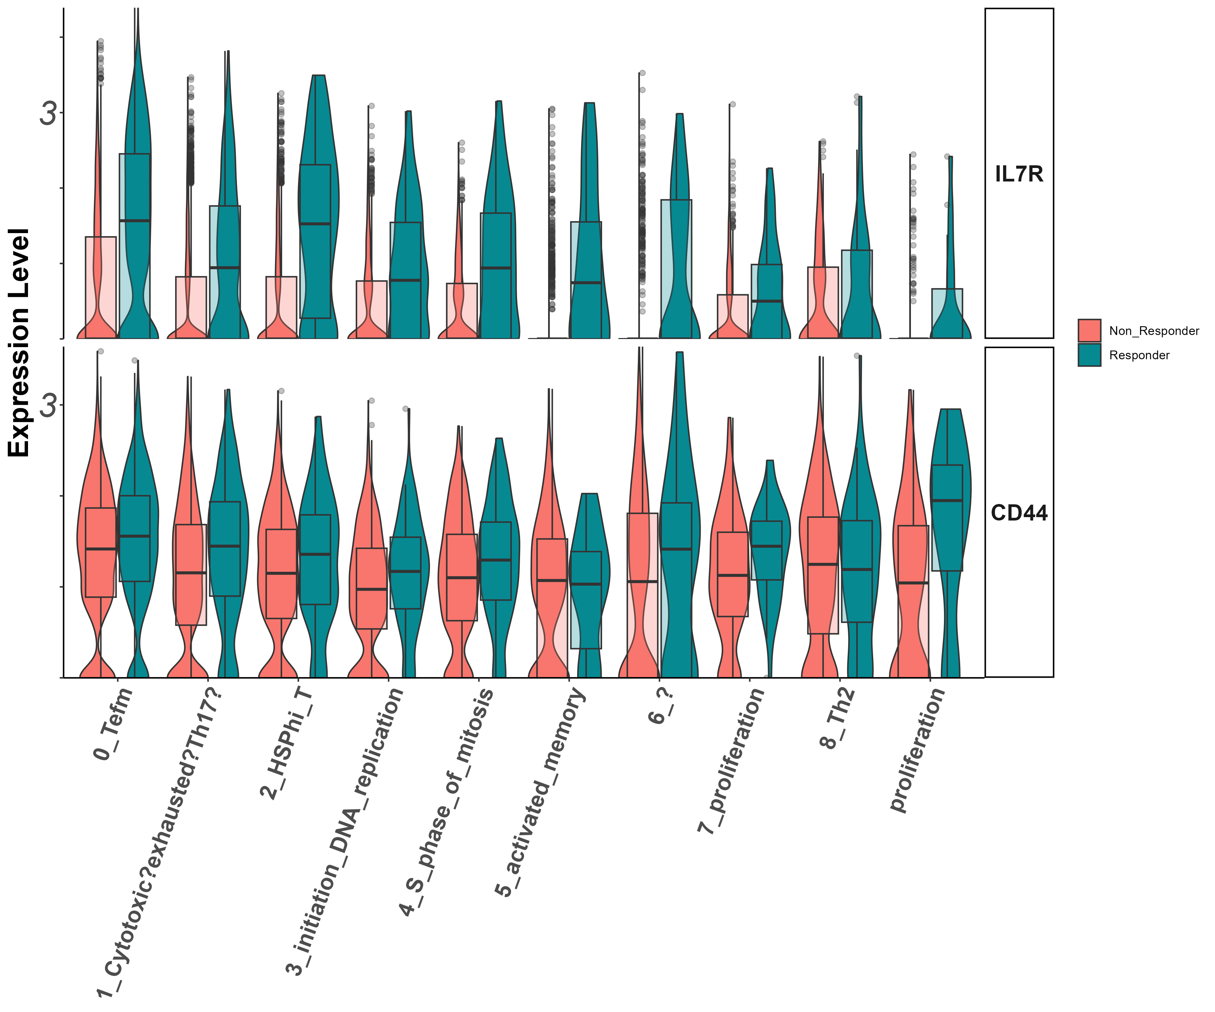
Stem/persister/naïve markers
Il7r, CD44
(vln)

Slide 27
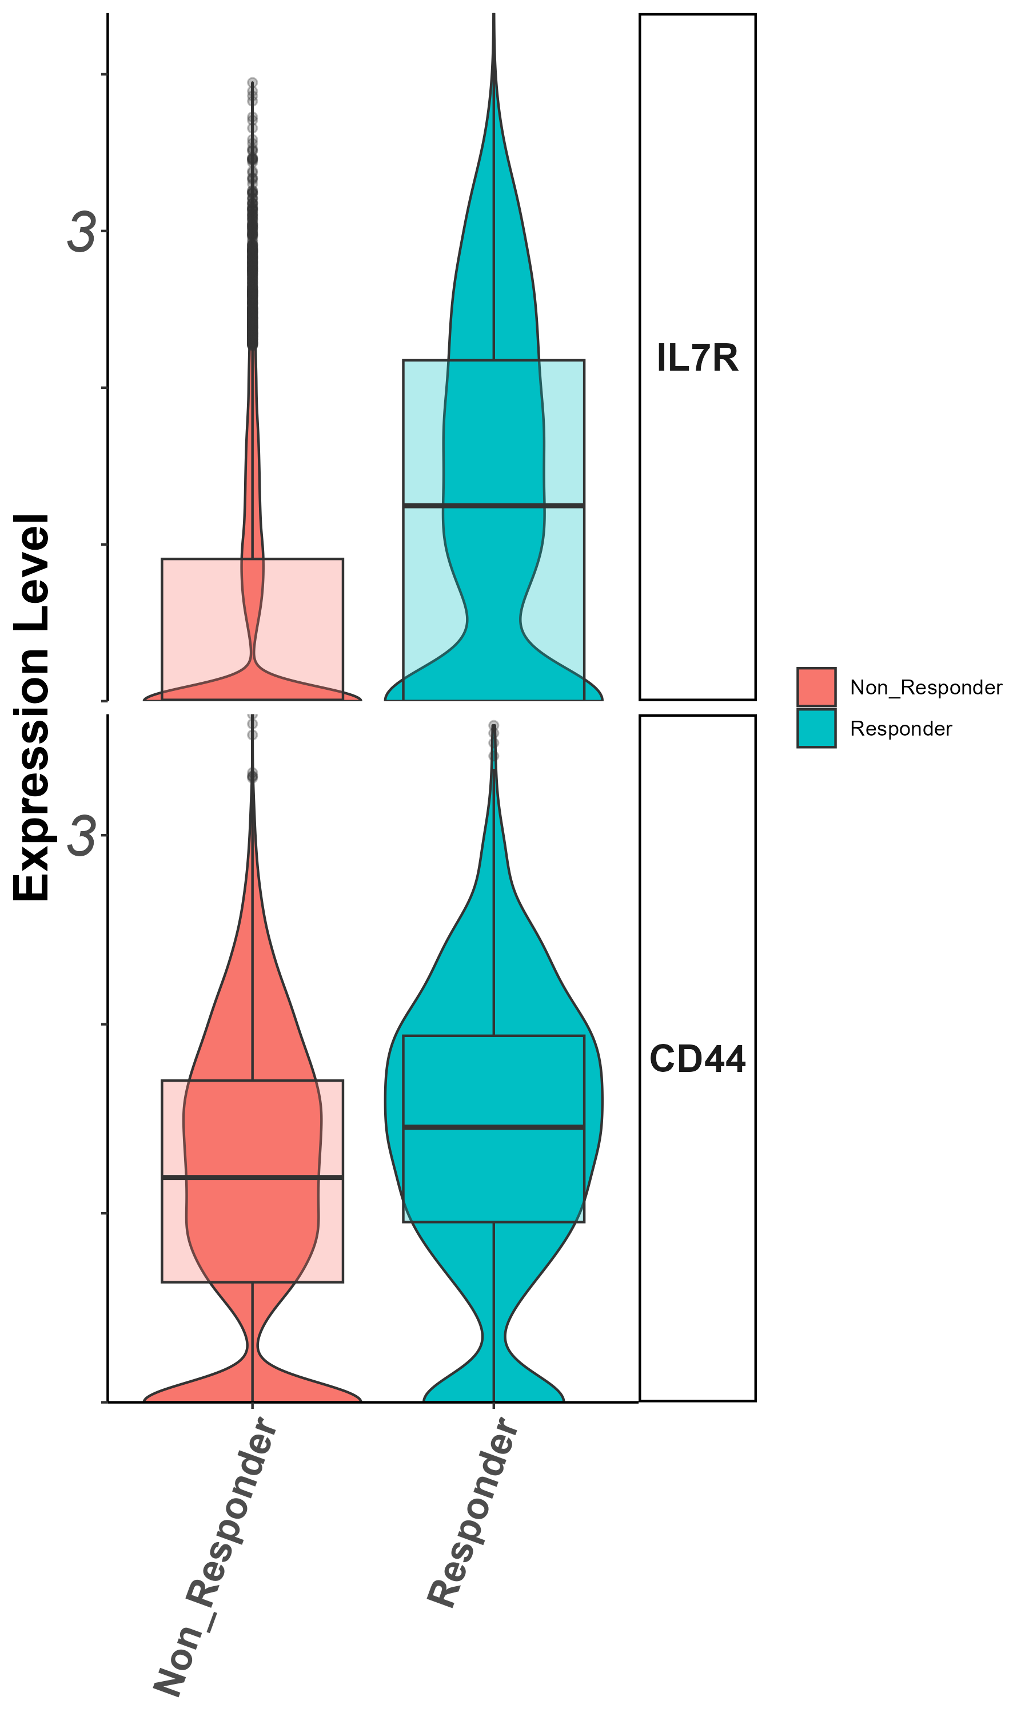
Stem/persister/naïve markers
Il7r, CD44
(groupby_treatment)

Slide 28
Summary cluster 0
Il7r : higher in responders – important anchor

Slide 29
Cluster 1 (cytotoxic CD8) zoom in analysis
Notes:
להוסיף ריבוע מדגיש לקלאסטר אפס

Slide 30
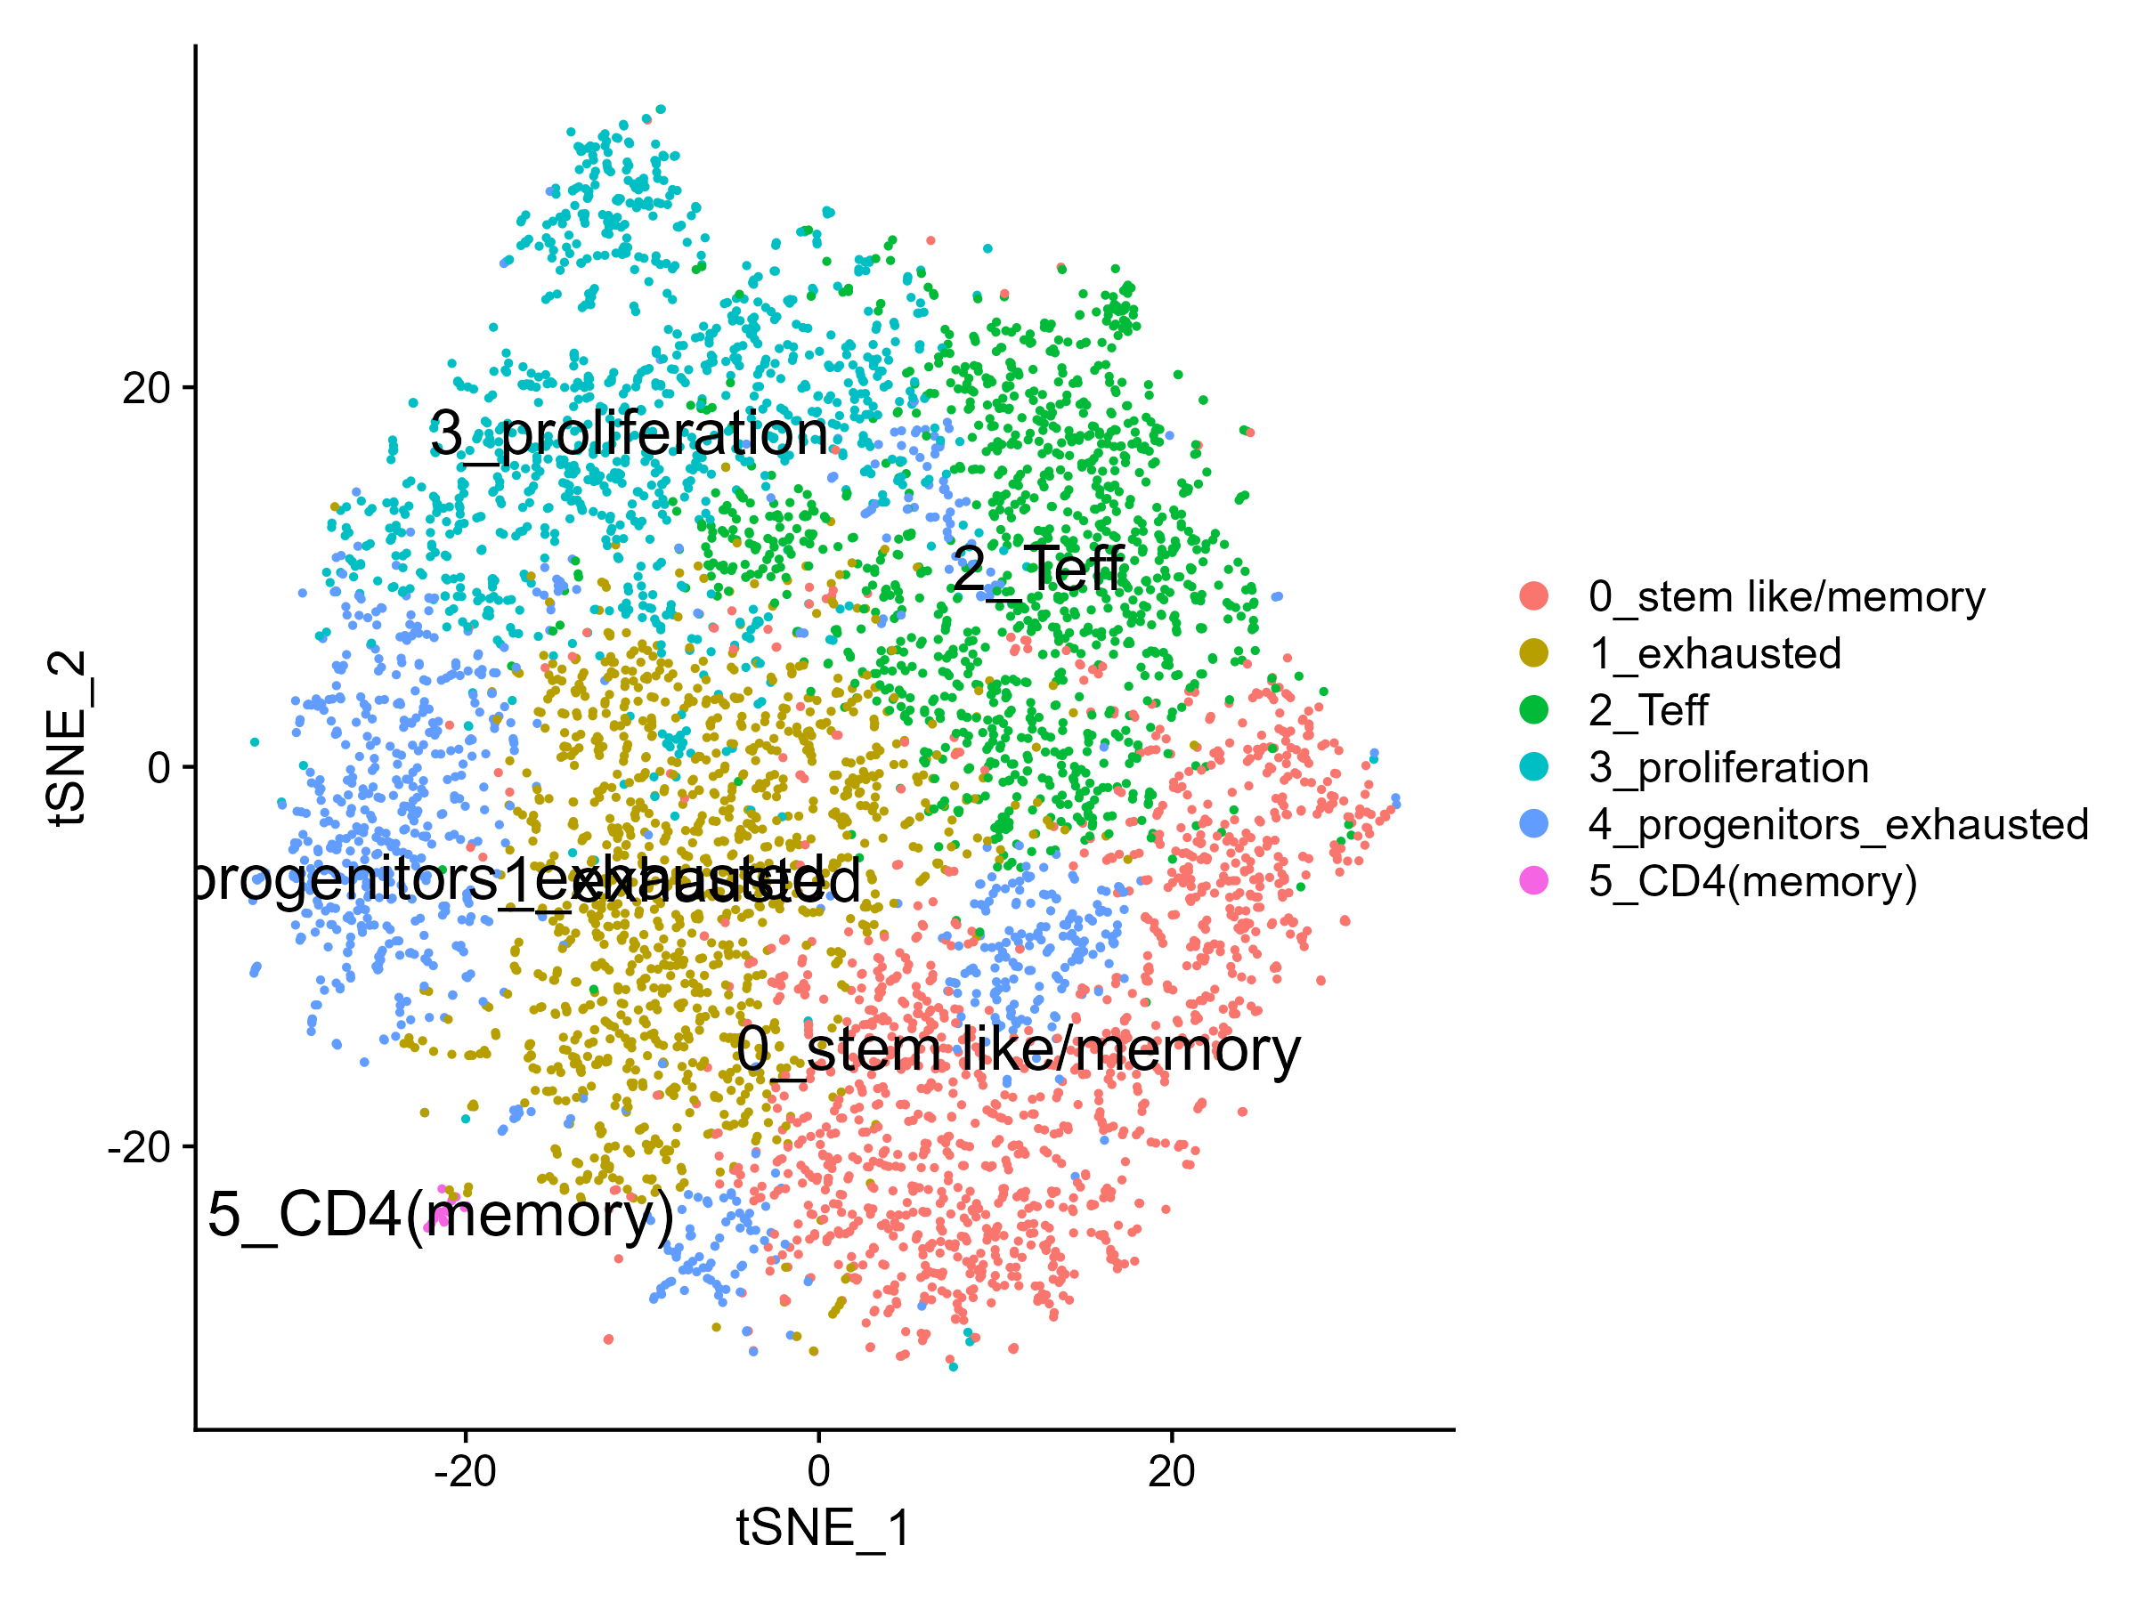
tSNE

Slide 31
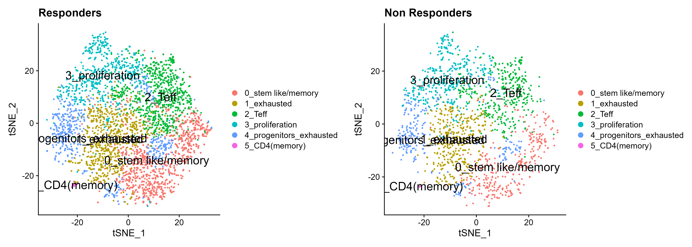
tSNE by response

Slide 32
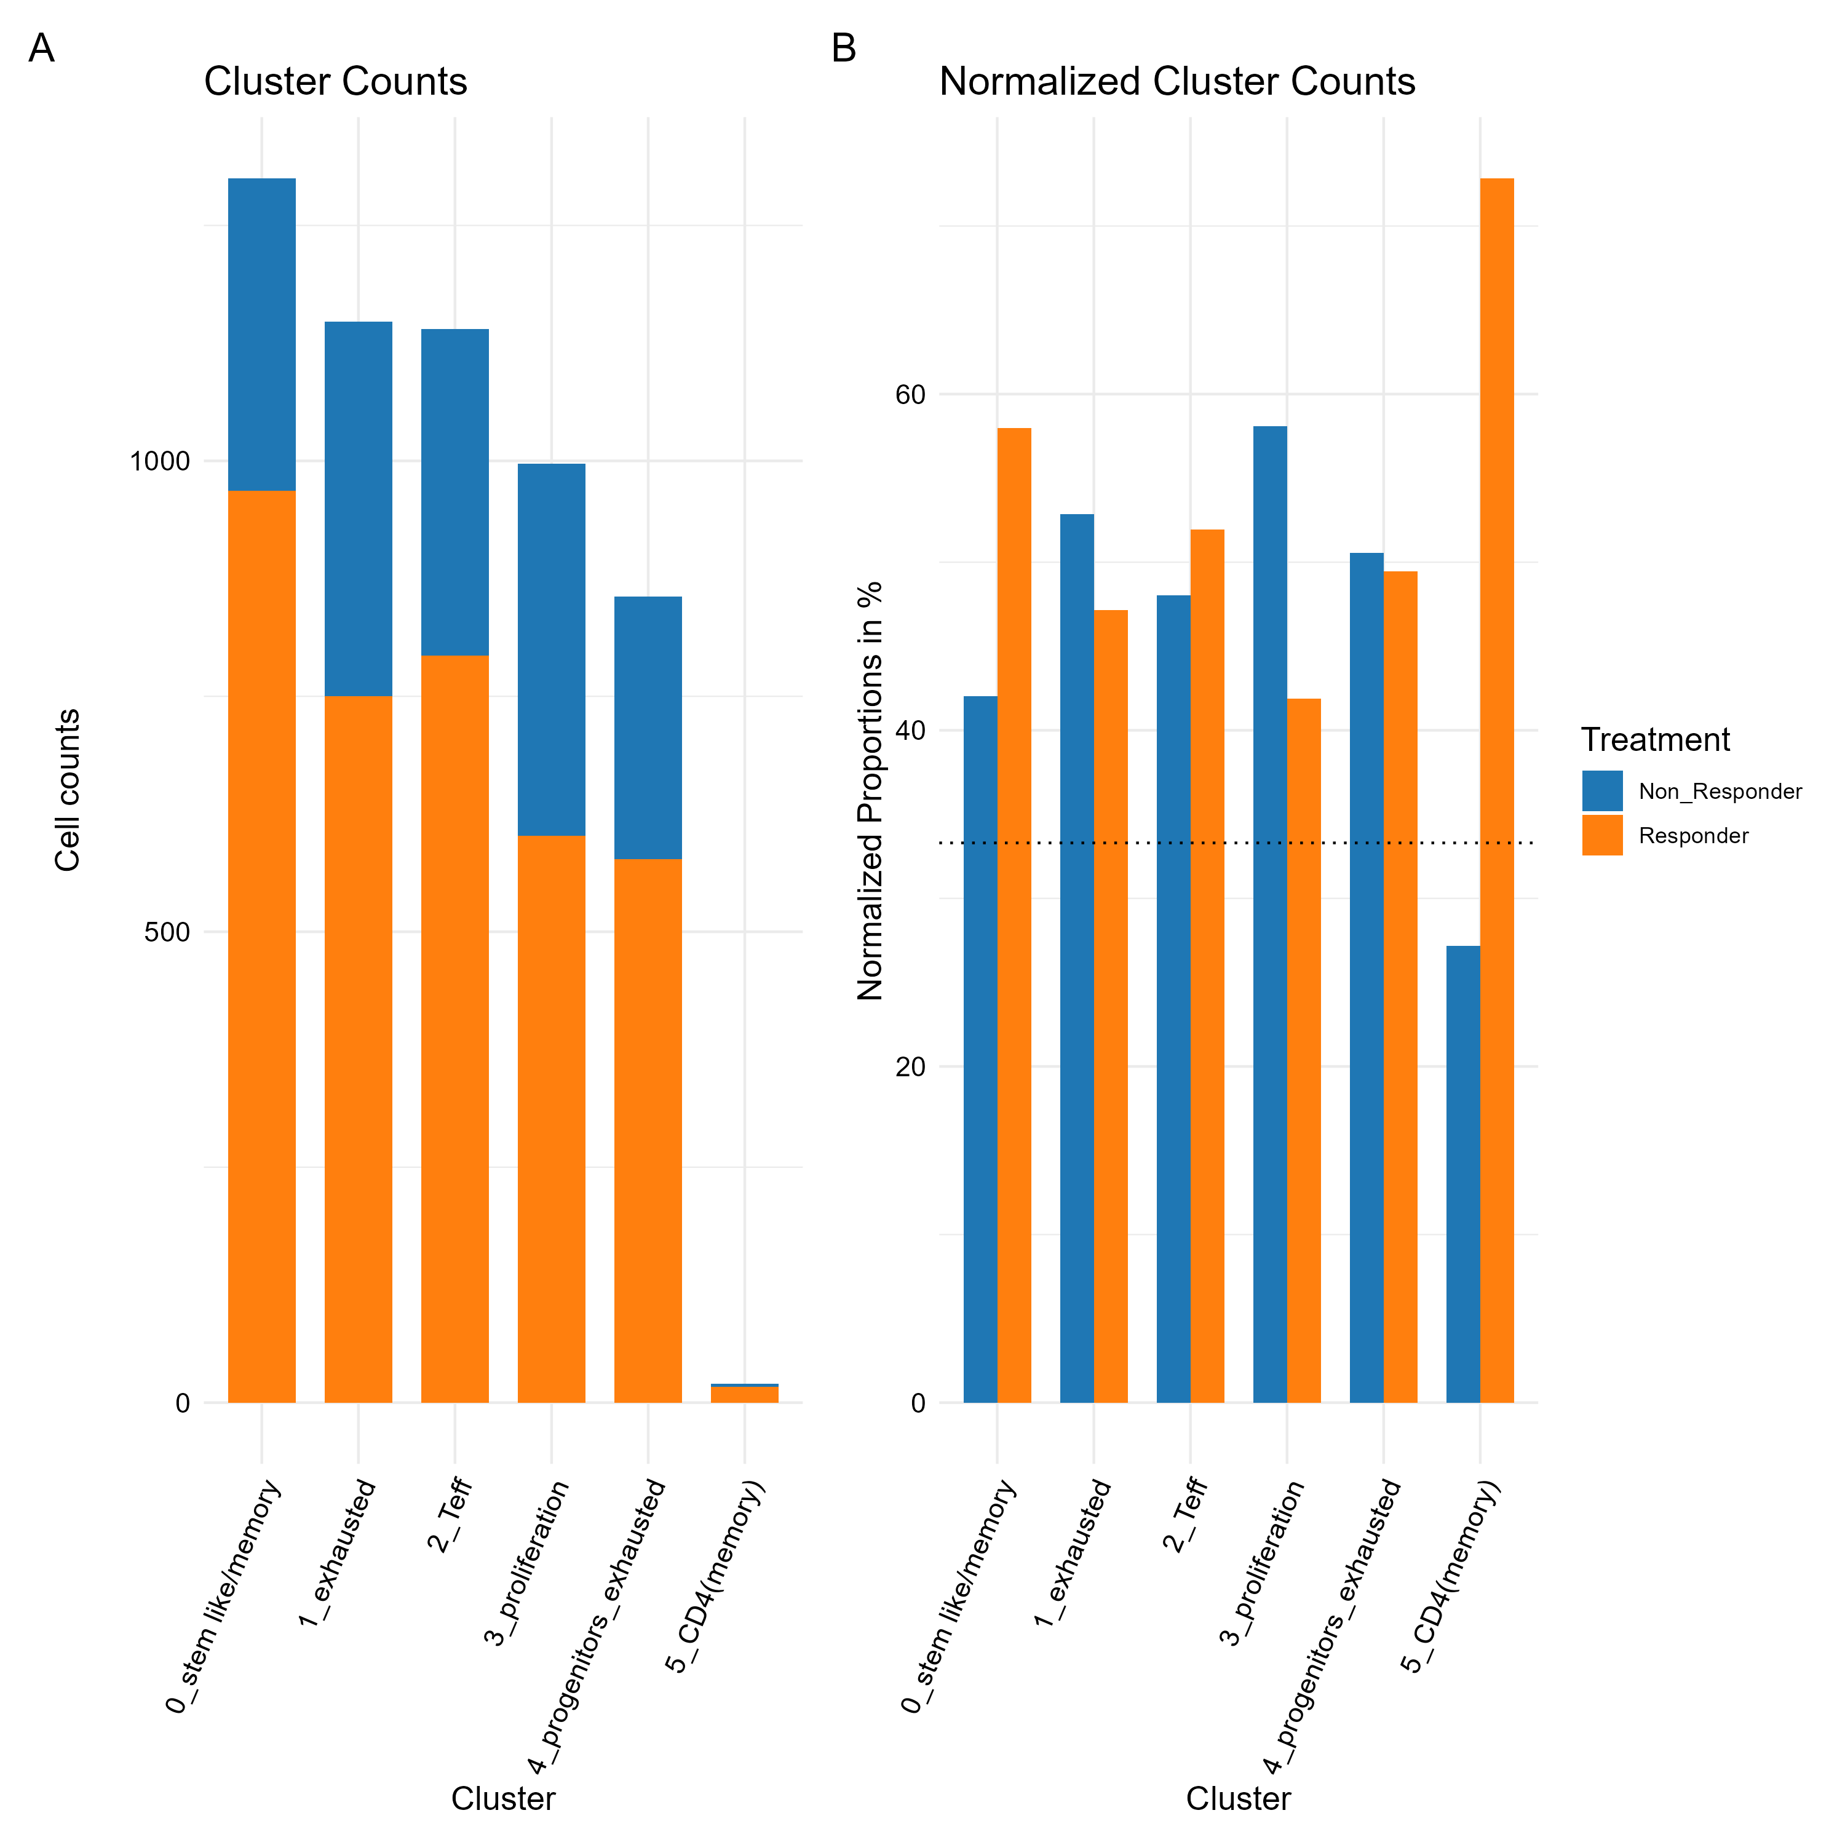
Cluster 1 zoom in analysis contribution per response

Slide 33
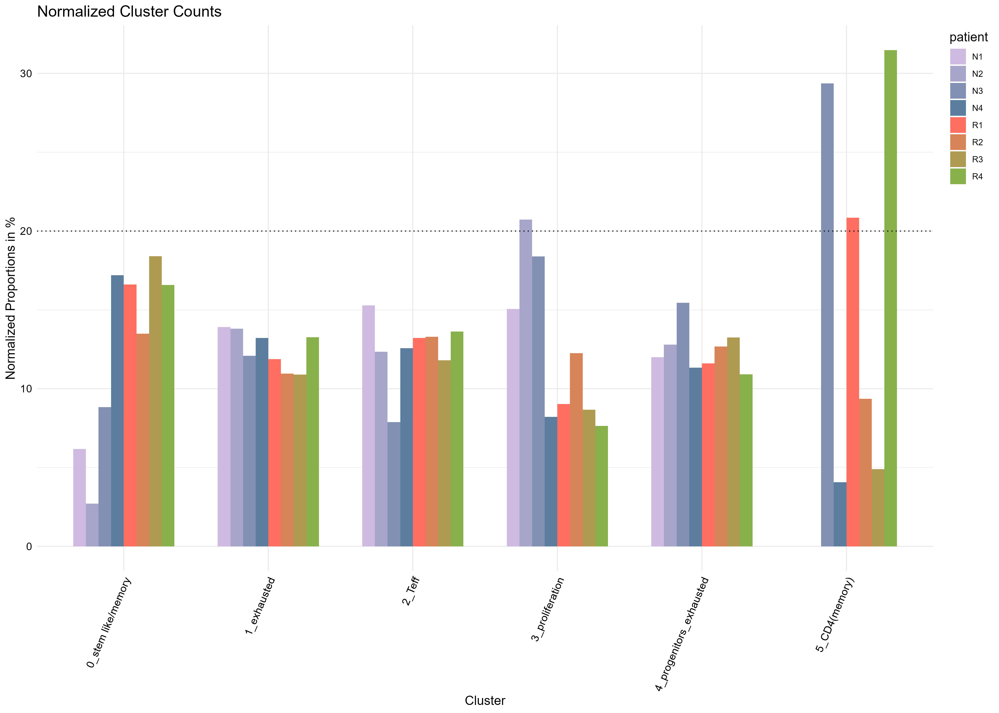
contribution per patient

Slide 34
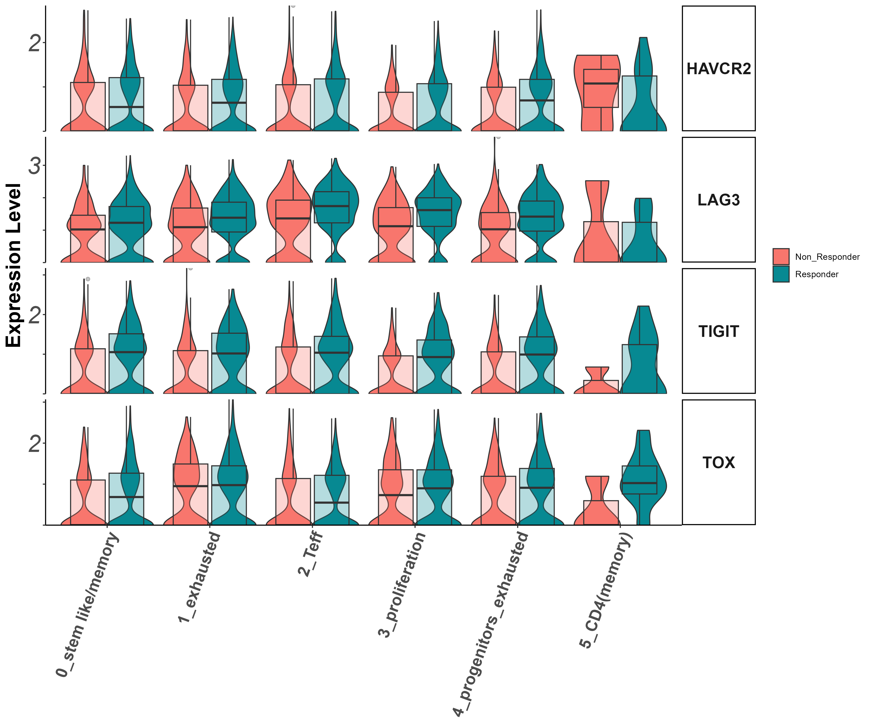
activation/exhaustion markers Tigit, Lag3, Havcr2, Tox (vln)

Slide 35
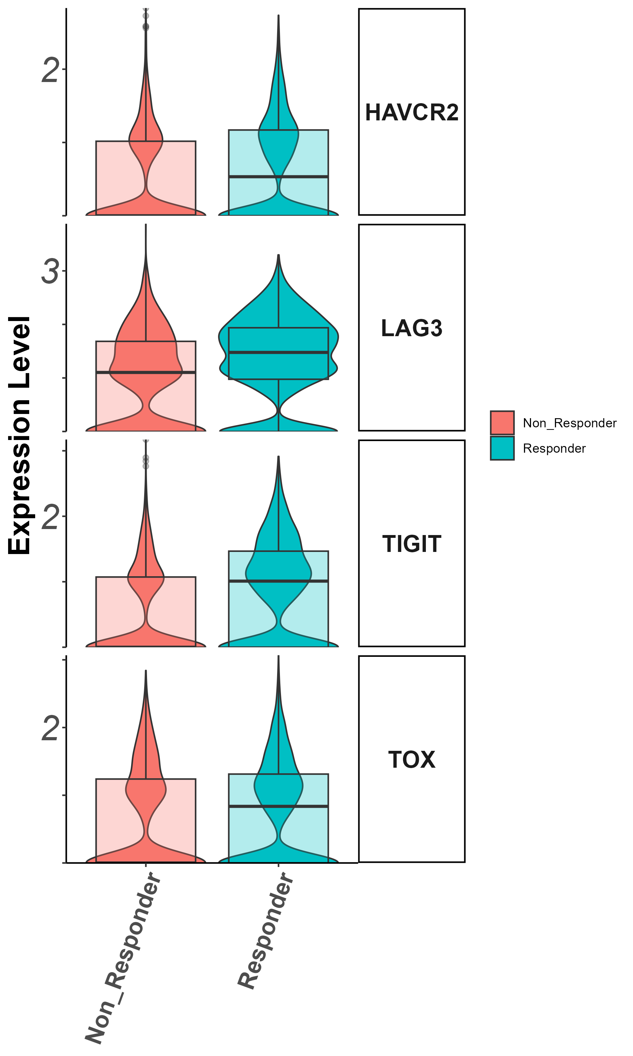
activation/exhaustion markers Tigit, Lag3, Havcr2, Tox
(groupby_treatment)

Slide 36
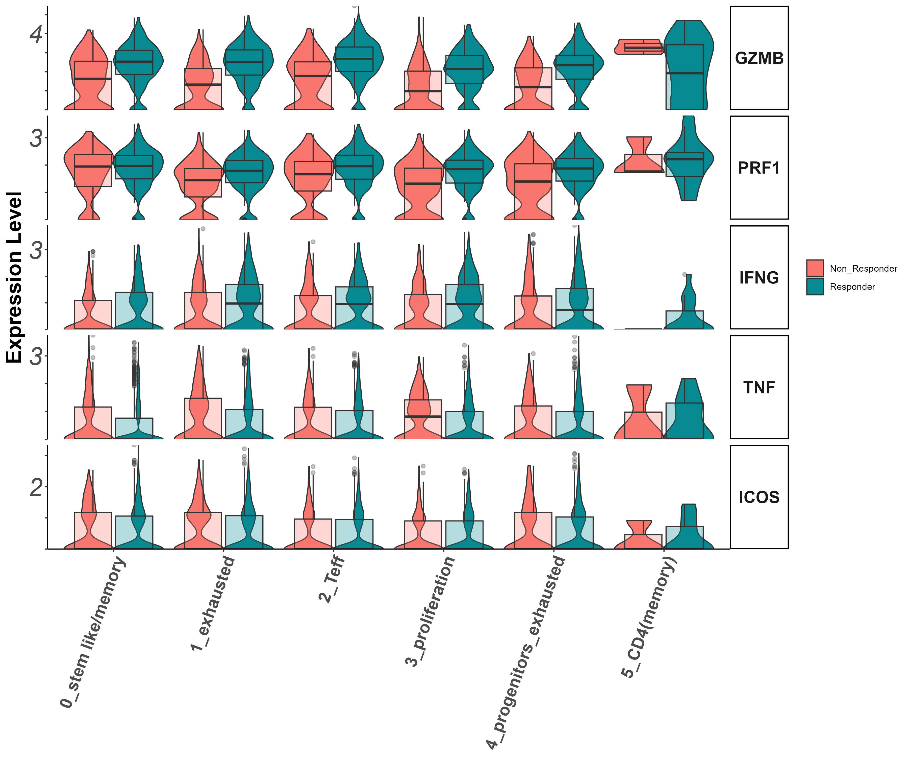
Effector markers
Gzmb, Prf1, Ifng, Il7r (vln)

Slide 37
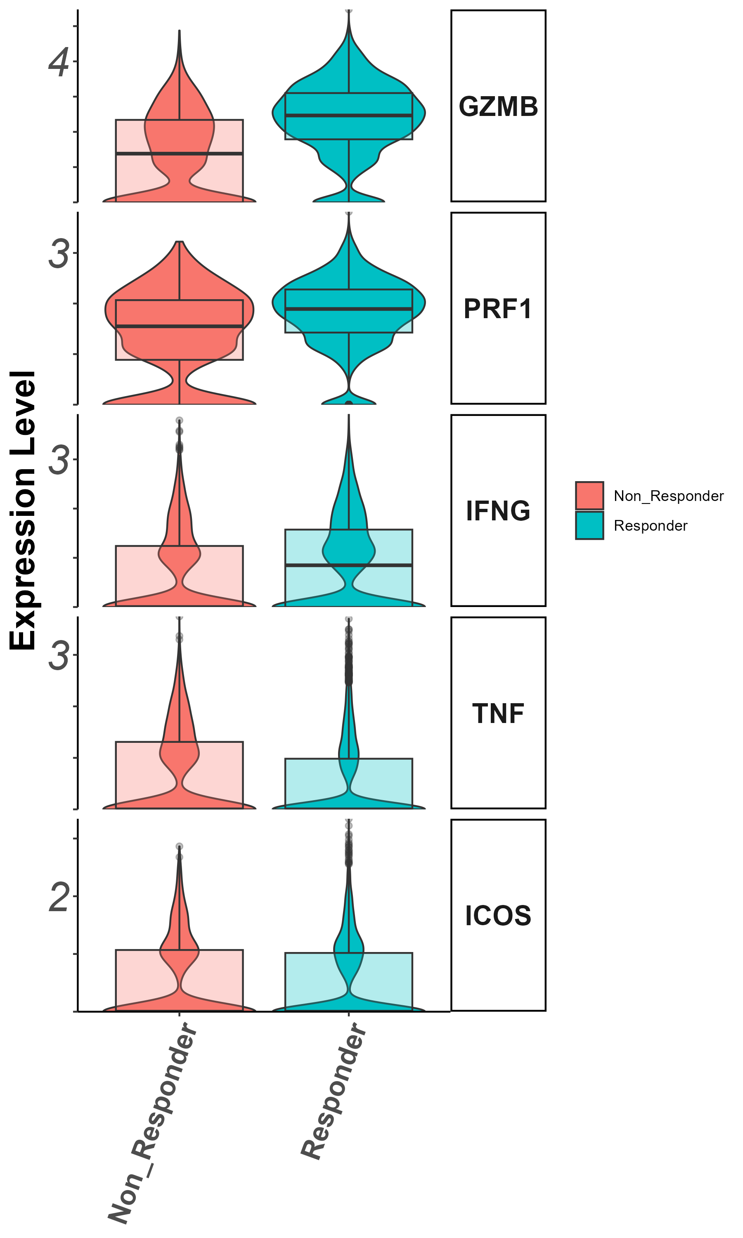
Effector markers
Gzmb, Prf1, Ifng, Il7r (groupby_treatment)

Slide 38
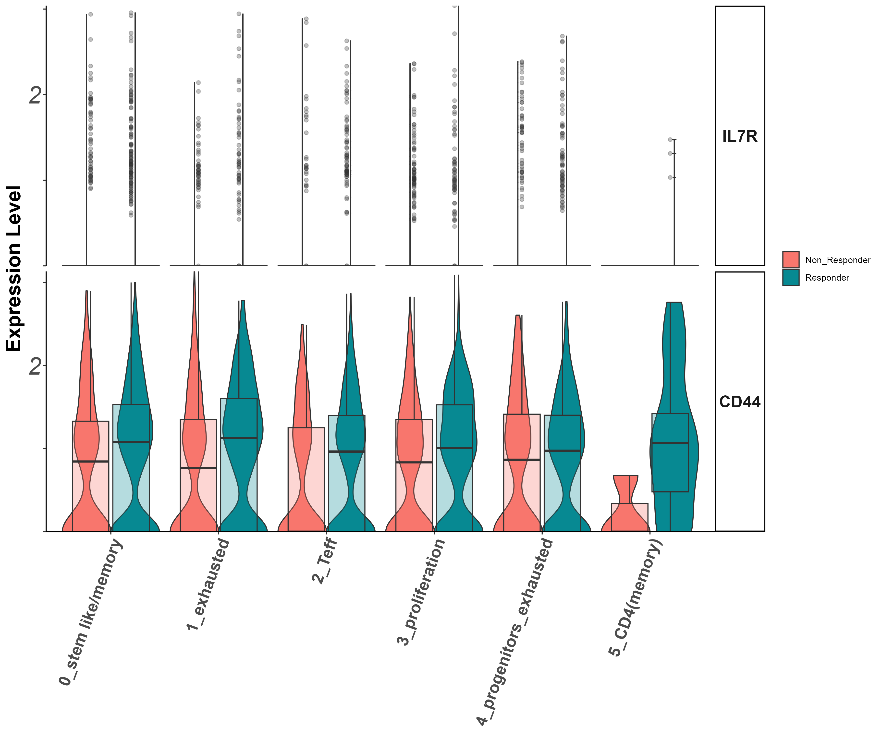
Stem/persister/naïve markers
Il7r, CD44
(vln)

Slide 39
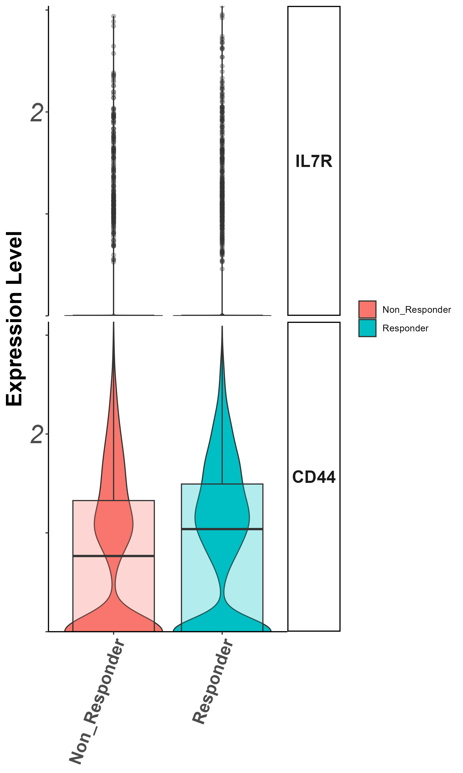
Stem/persister/naïve markers
Il7r, CD44
(groupby_treatment)

Slide 40
Summary cluster 1
CD40LG higher in non responders. what is this?
klf2, bach2, CD27, higher in responders (?)
CD44 higher in responders

Slide 41
Cluster 2 (cytotoxic CD8) zoom in analysis
Notes:
להוסיף ריבוע מדגיש לקלאסטר אפס

Slide 42
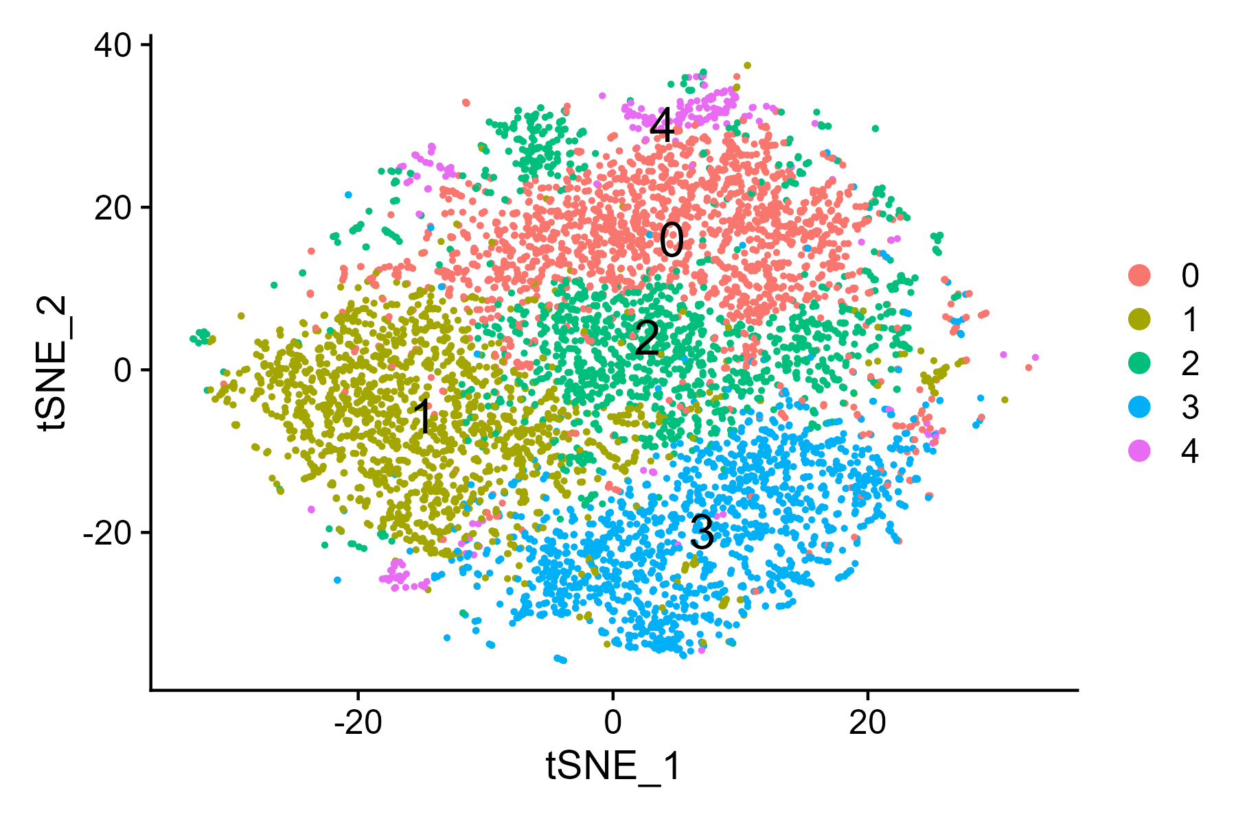
tSNE

Slide 43
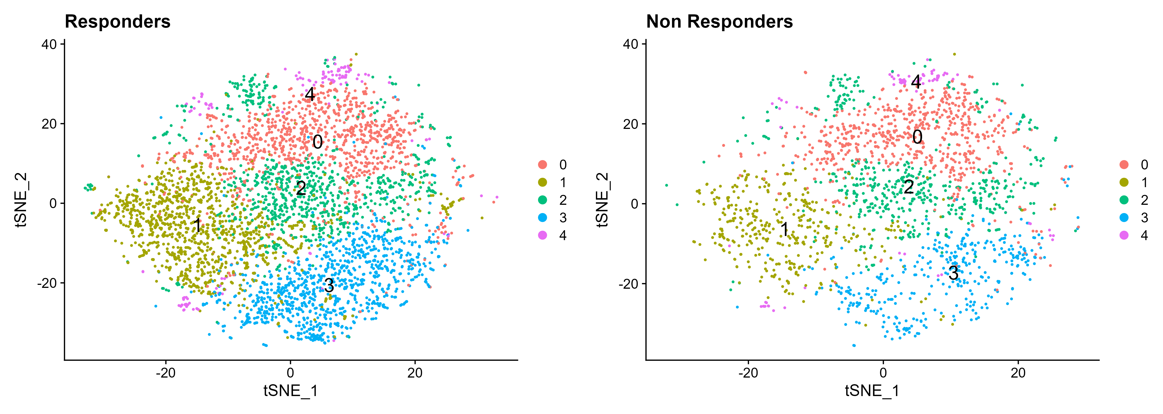
tSNE by response

Slide 44
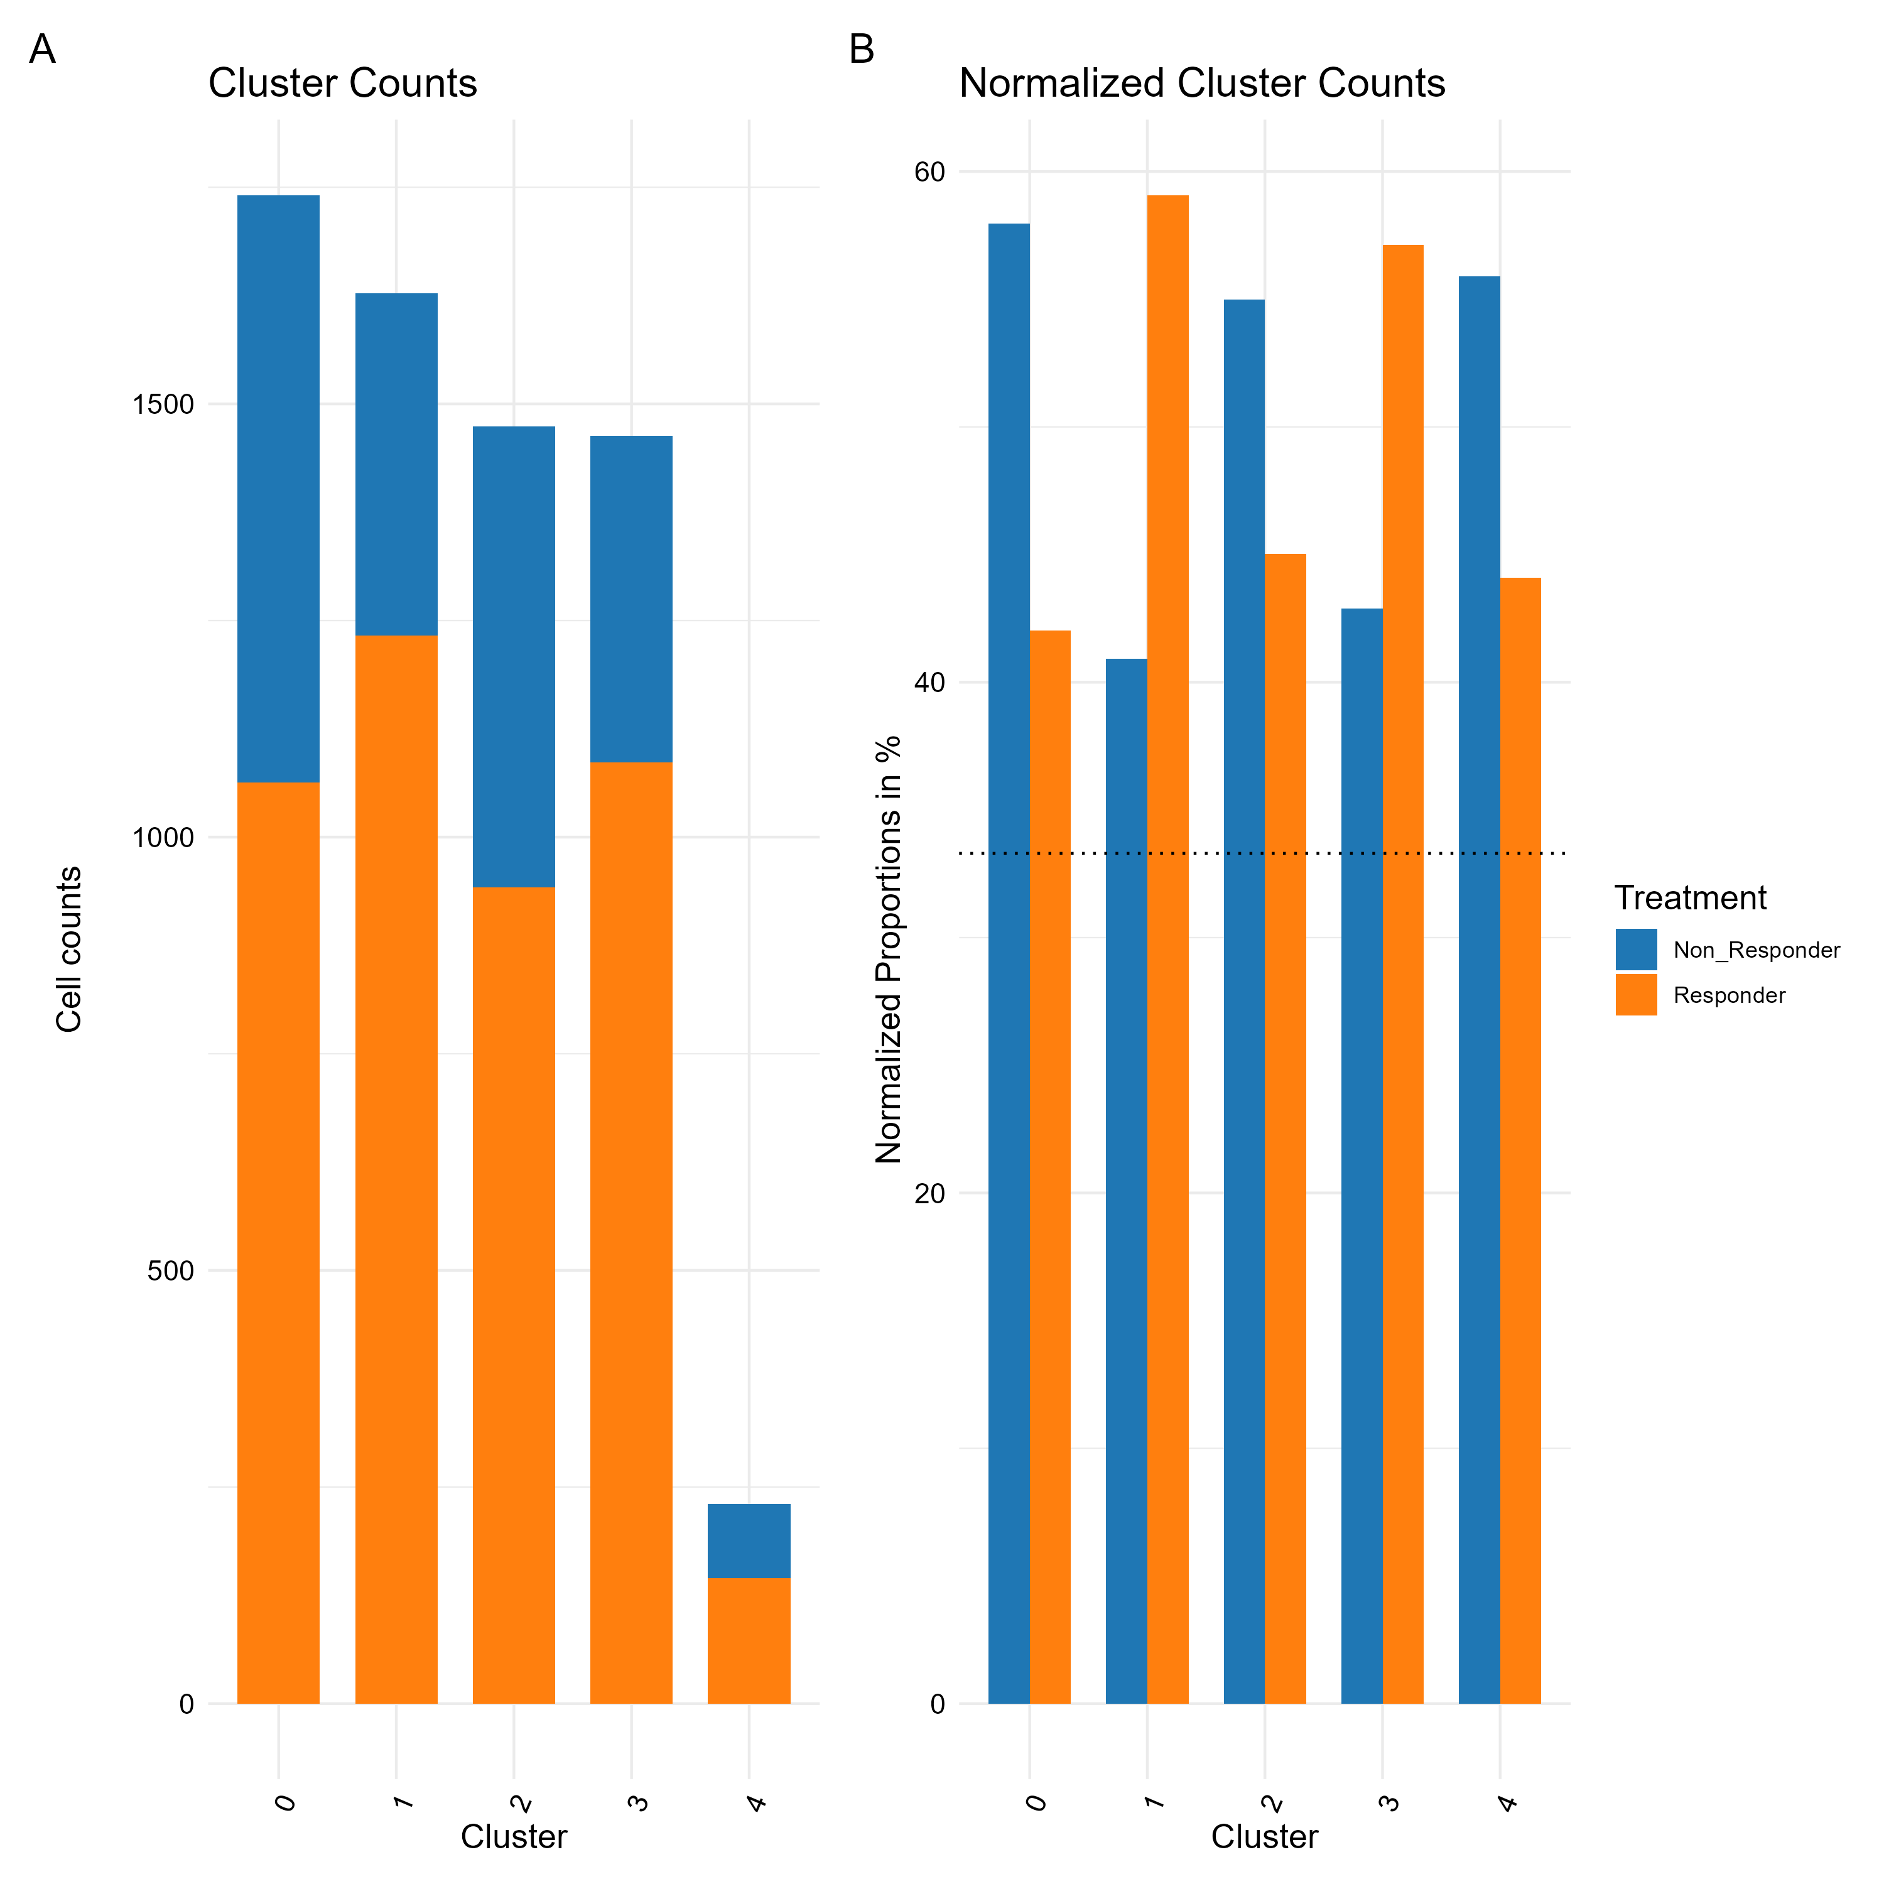
Cluster 2 zoom in analysis contribution per response

Slide 45
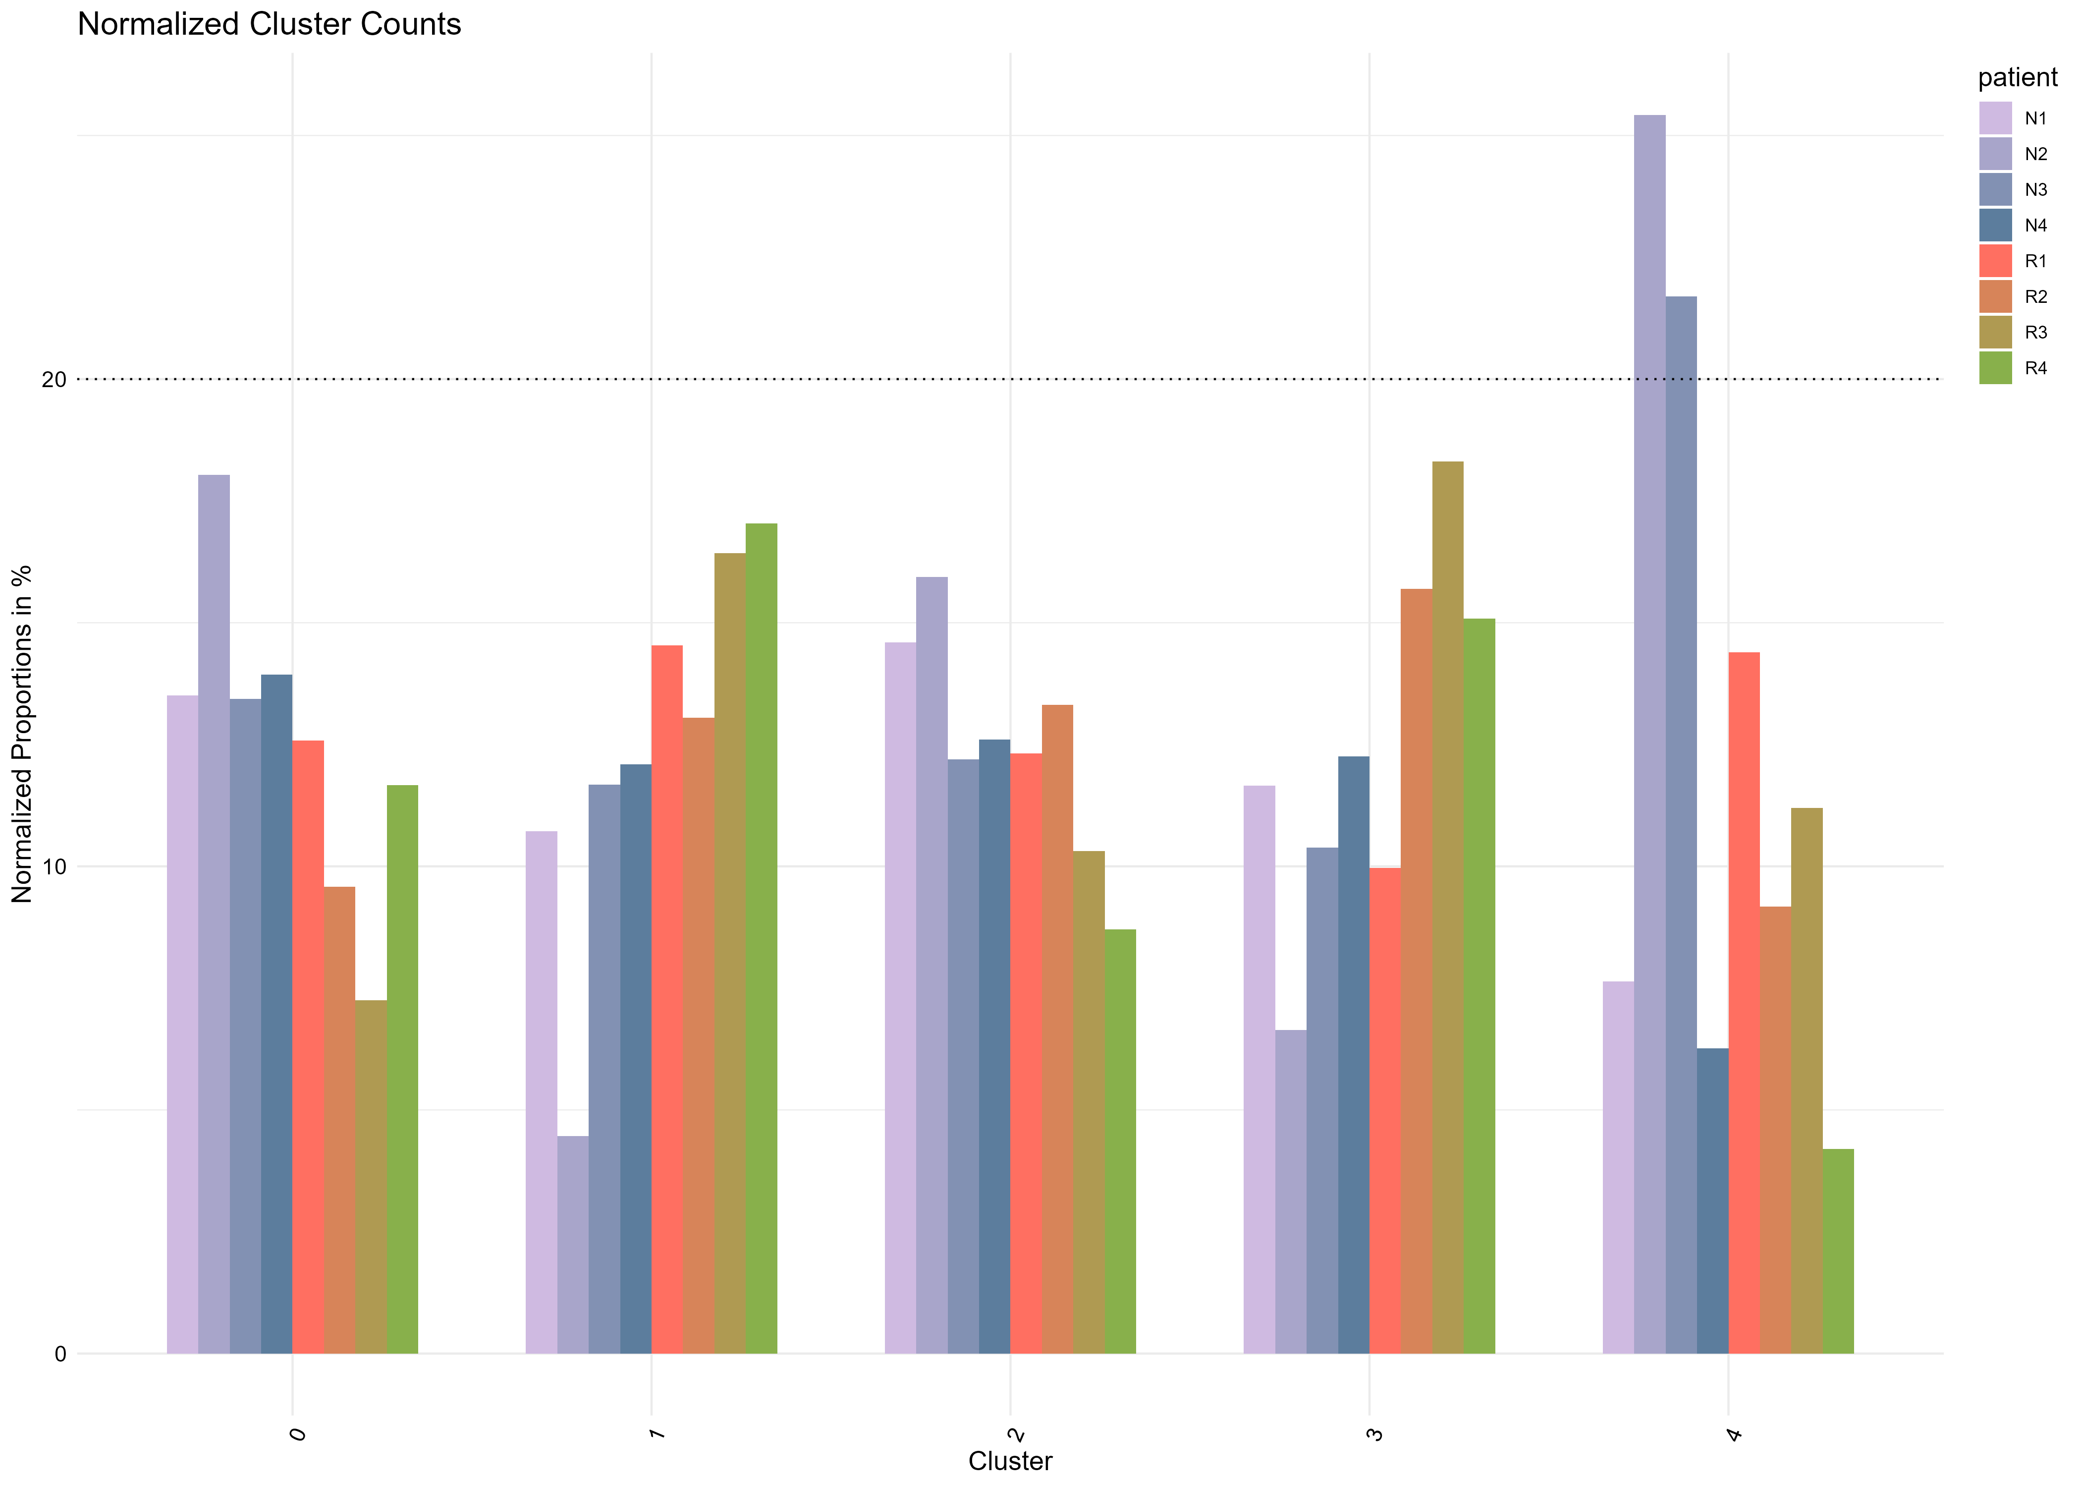
contribution per patient

Slide 46
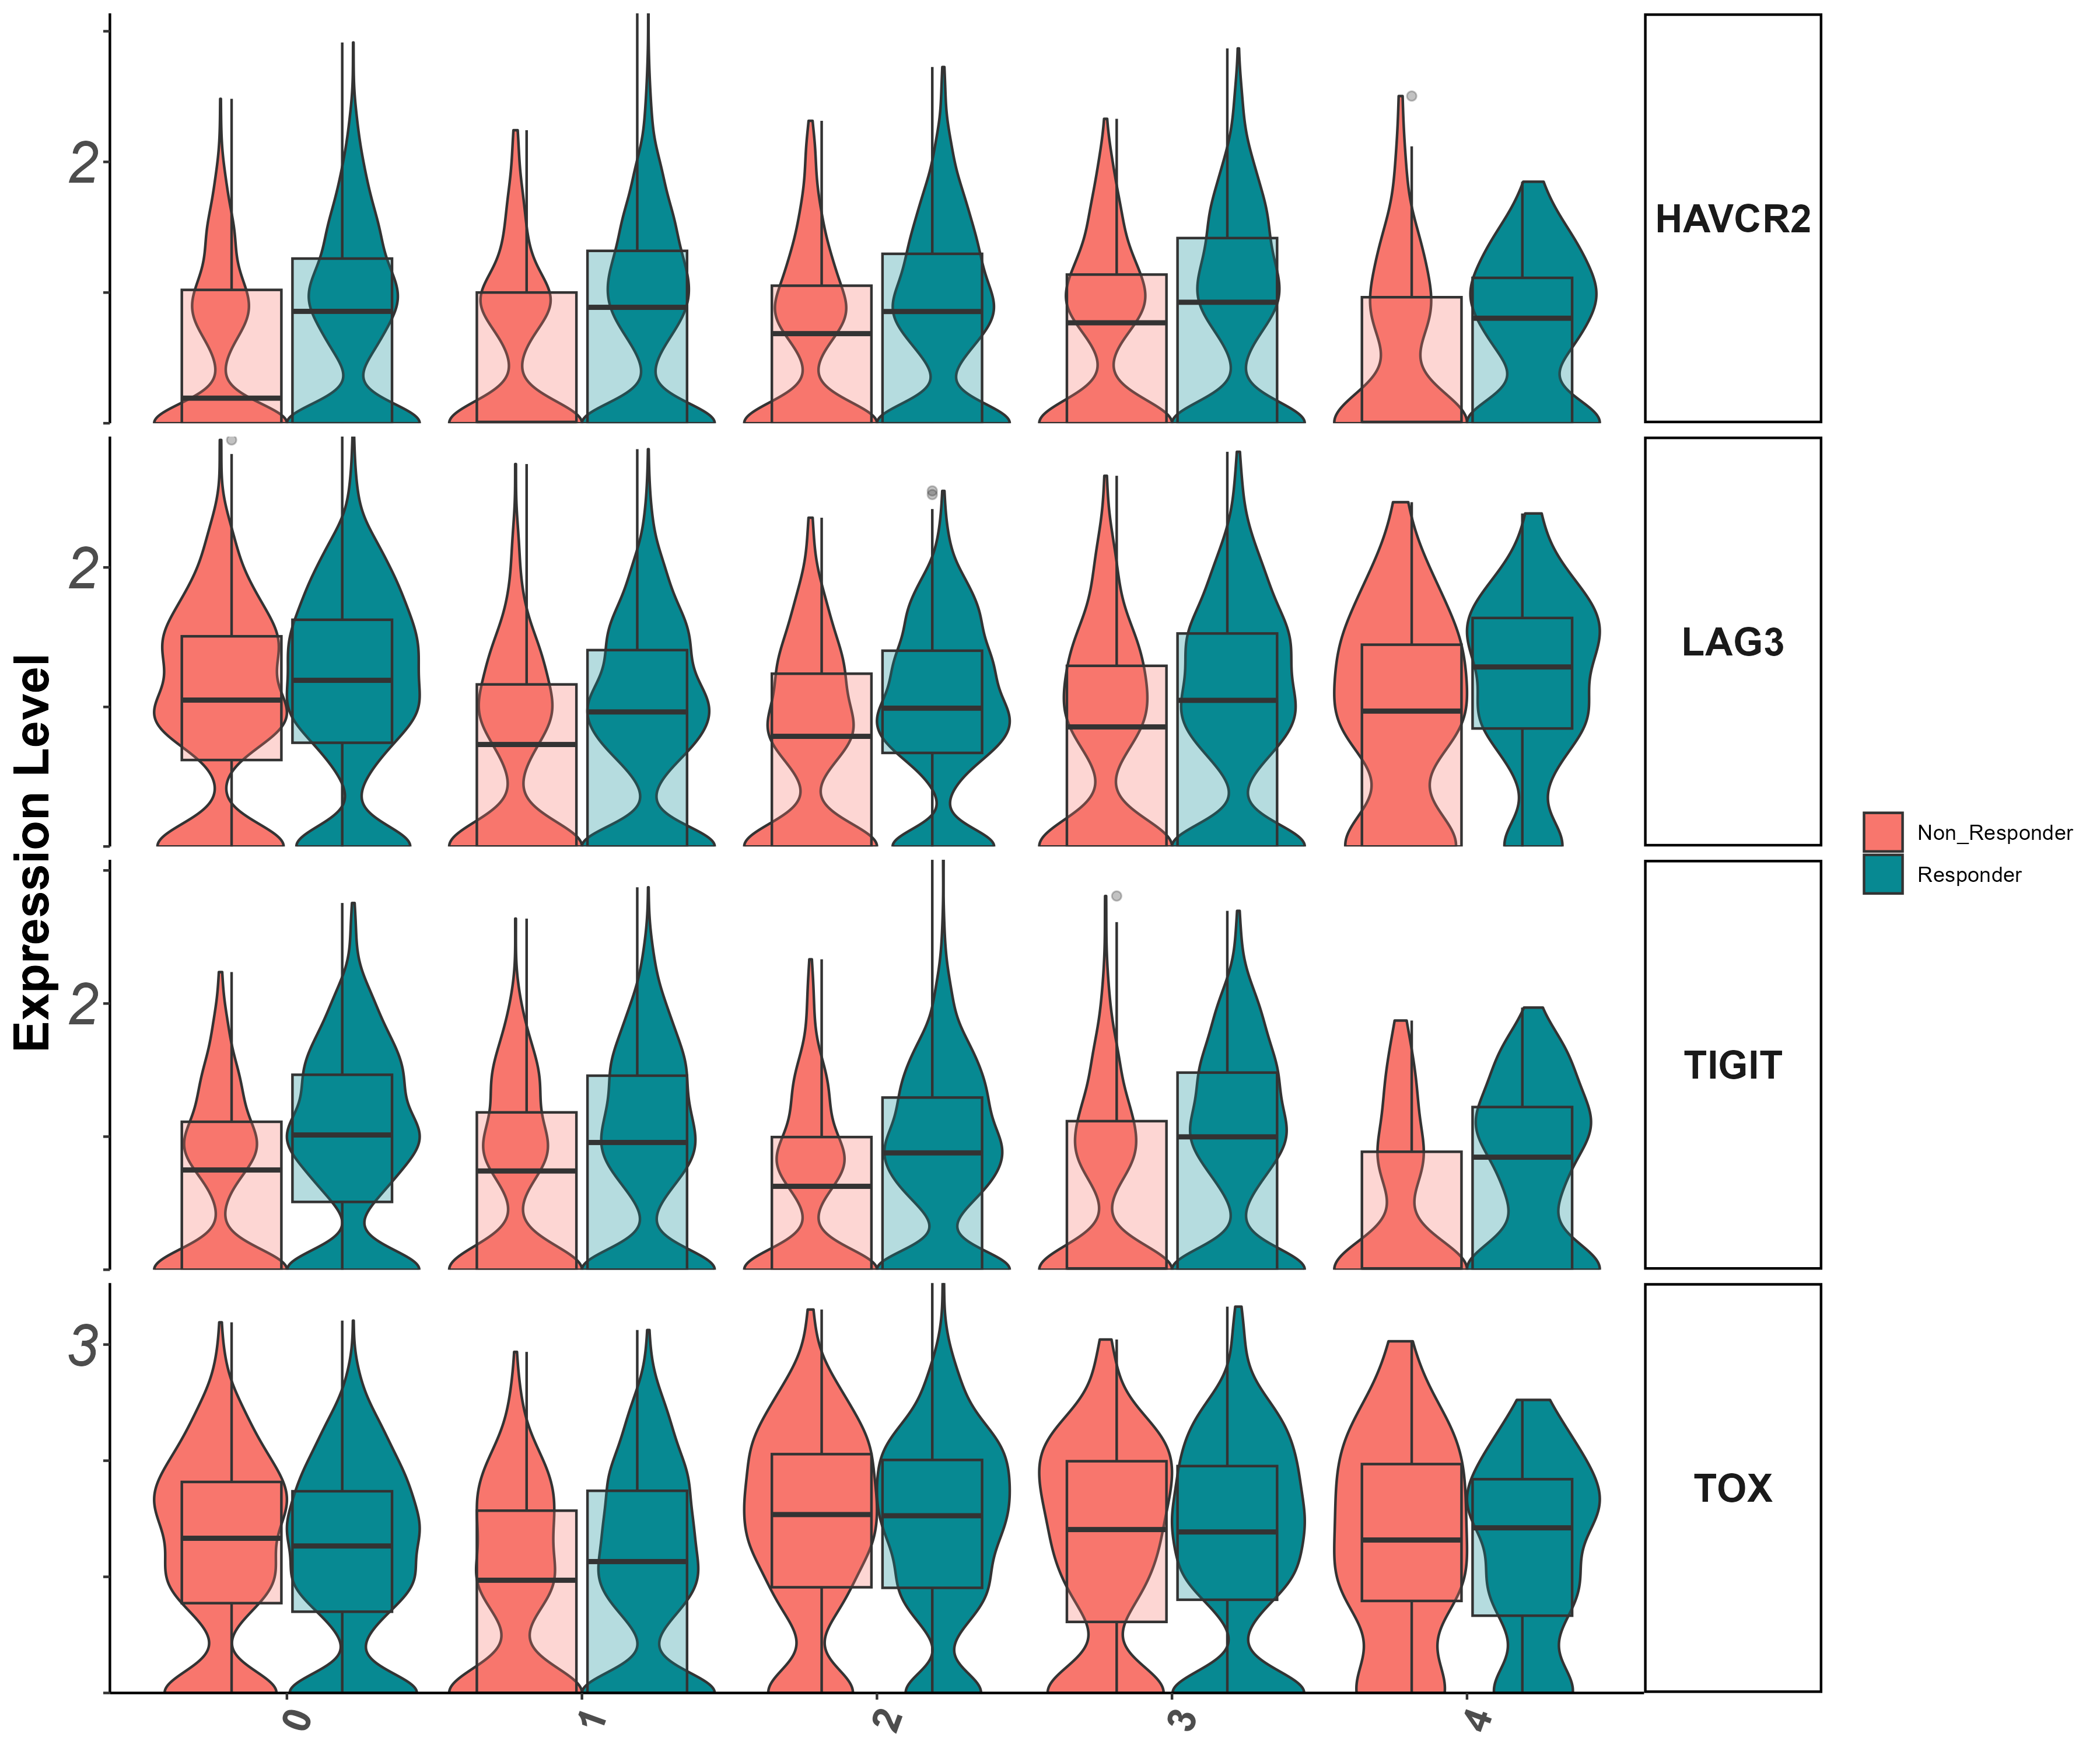
activation/exhaustion markers Tigit, Lag3, Havcr2, Tox (vln)

Slide 47
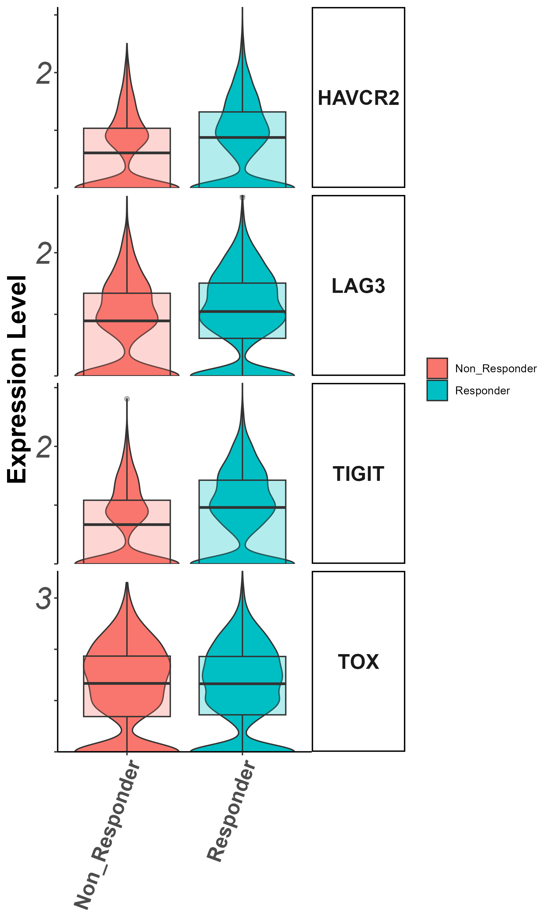
activation/exhaustion markers Tigit, Lag3, Havcr2, Tox
(groupby_treatment)

Slide 48
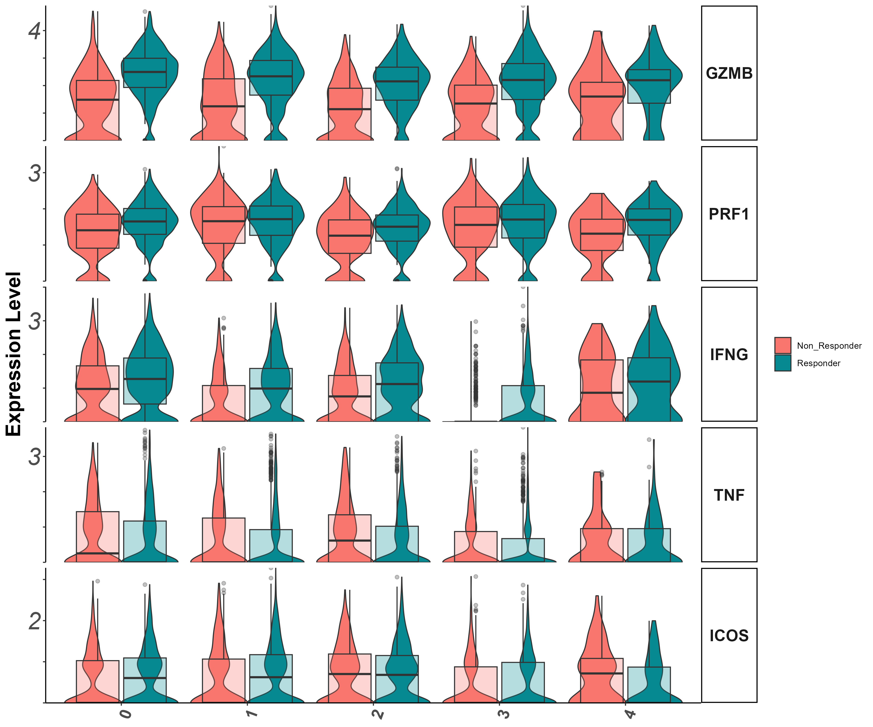
Effector markers
Gzmb, Prf1, Ifng, Il7r (vln)

Slide 49
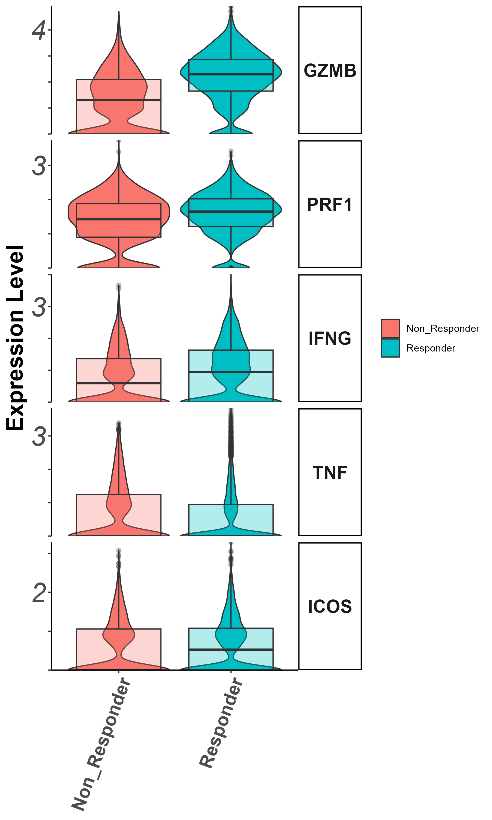
Effector markers
Gzmb, Prf1, Ifng, Il7r (groupby_treatment)

Slide 50
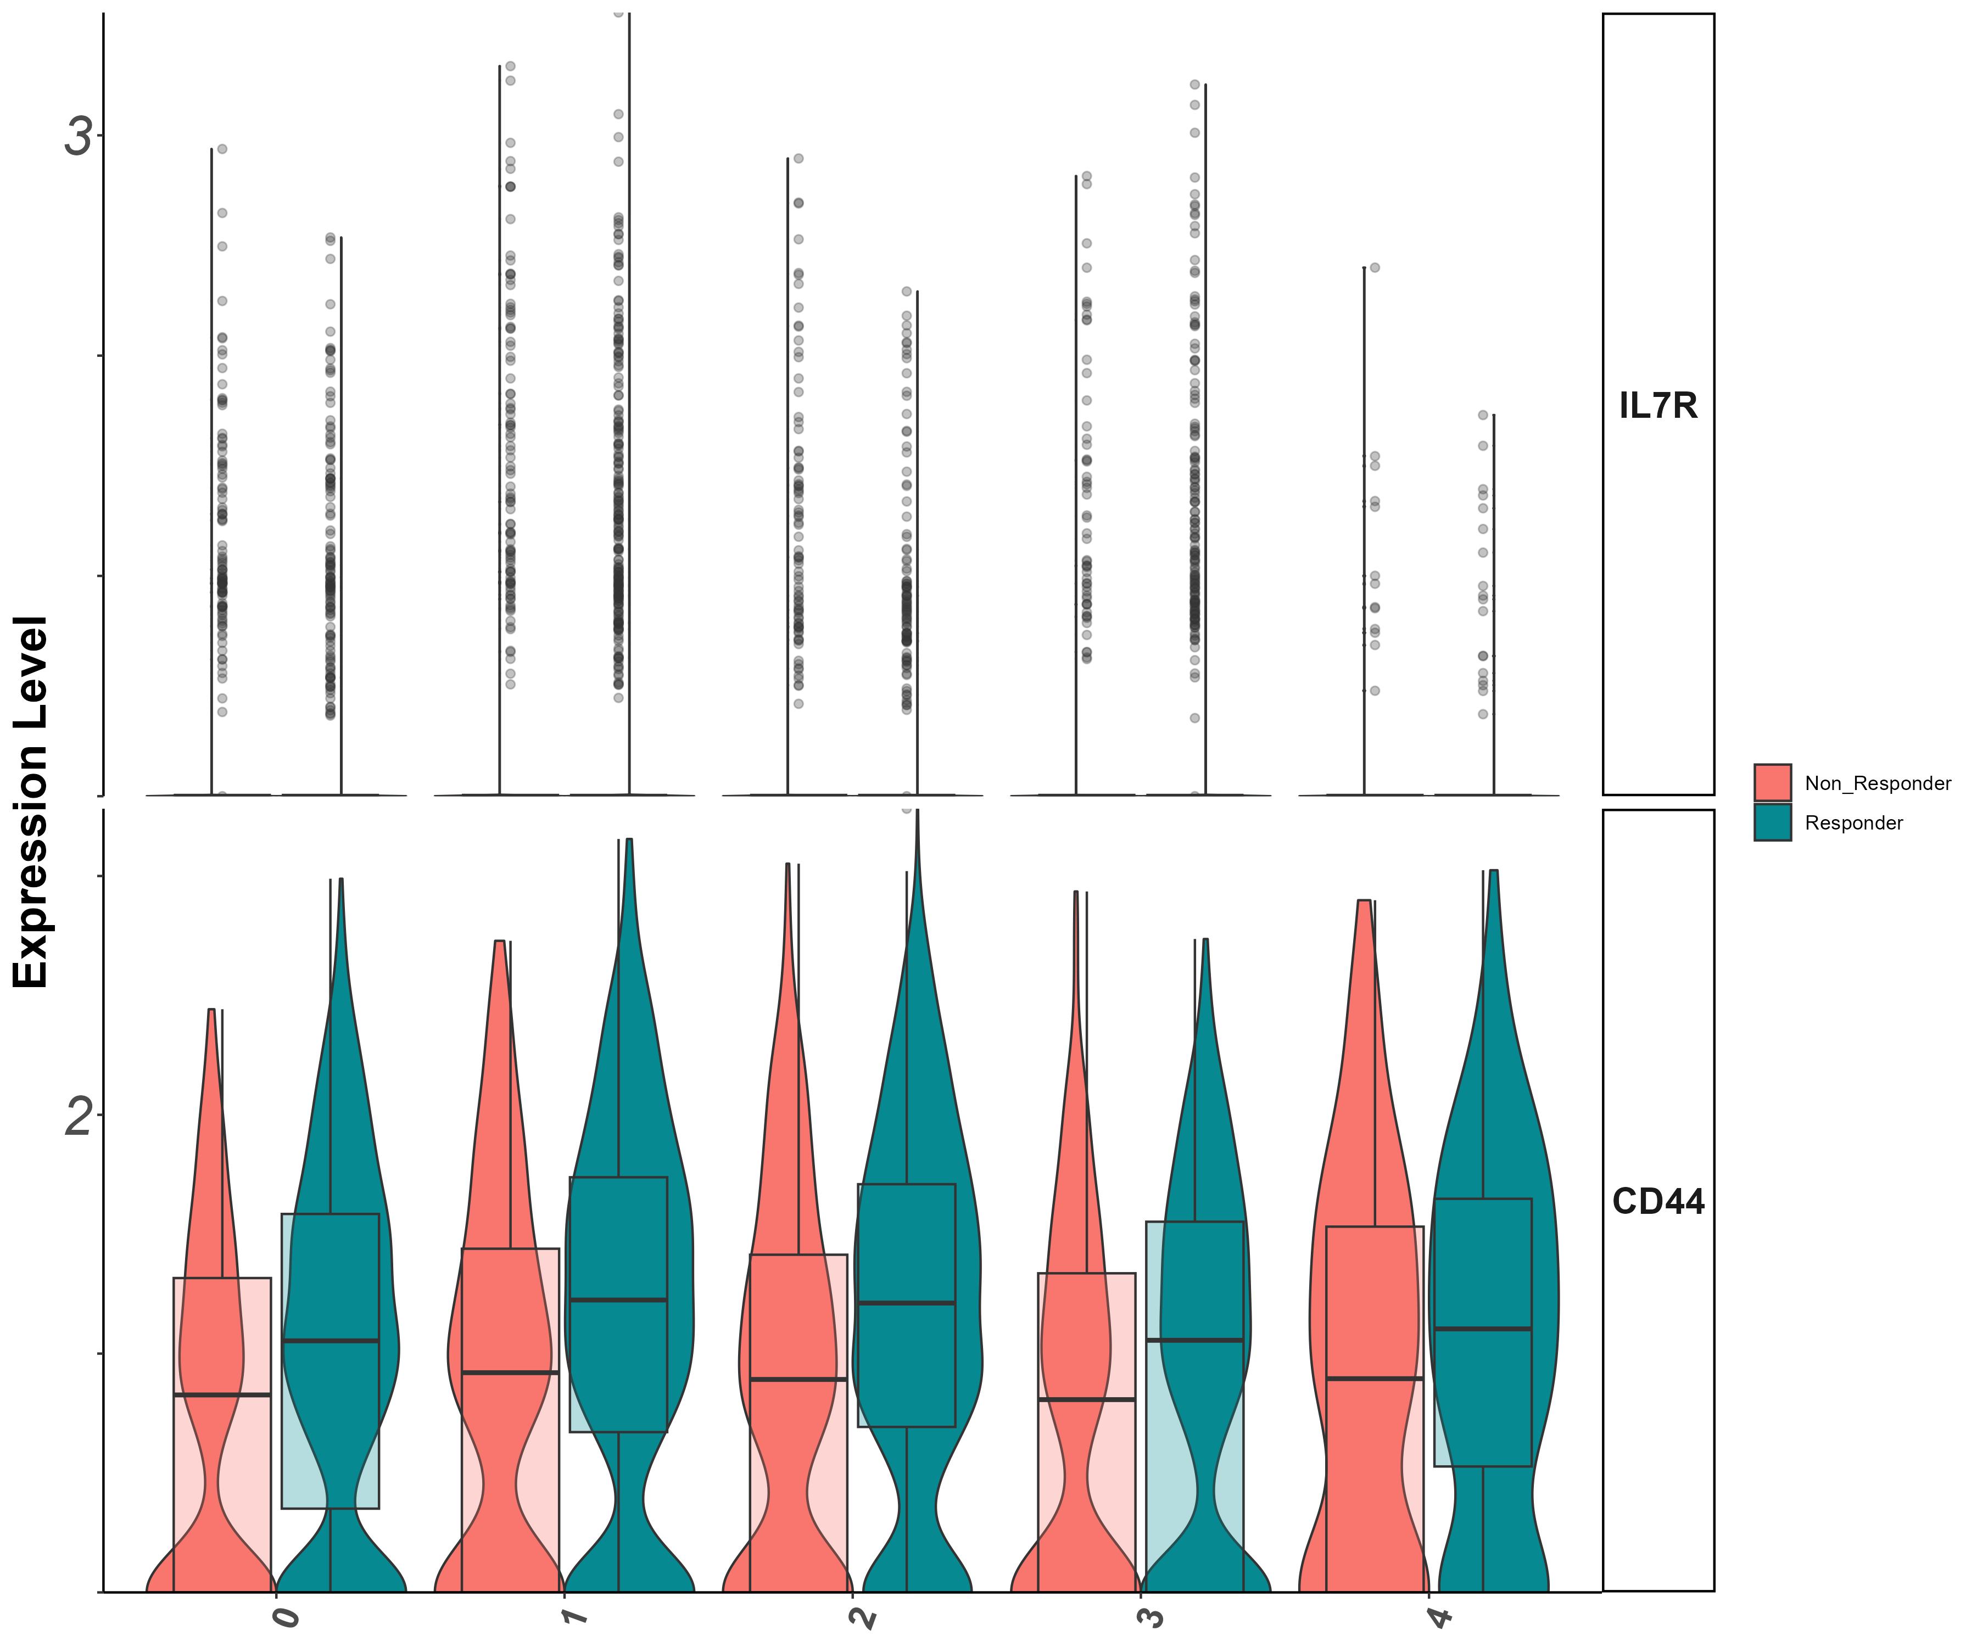
Stem/persister/naïve markers
Il7r, CD44
(vln)

Slide 51
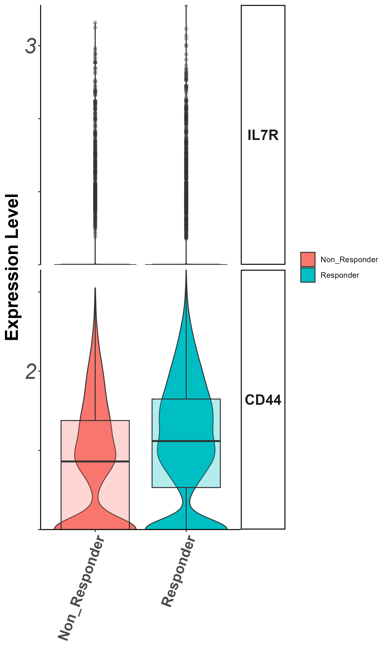
Stem/persister/naïve markers
Il7r, CD44
(groupby_treatment)

Slide 52
Summary cluster 2
- cluster 0,2 (inside clus2 analysis) more non-responders - cluster 1,3 more responders - CD40LG, ENTPD1, : higher in non responders - GZMB, prf1, IFNG, GZMK, CD27, : higher in responders - exhaustion : TIM3, TIGIT, TNF higher in respondesr - naive-like/memory : CD44, higher in responders - effector/memory : KLF2, higher in responders

Slide 53
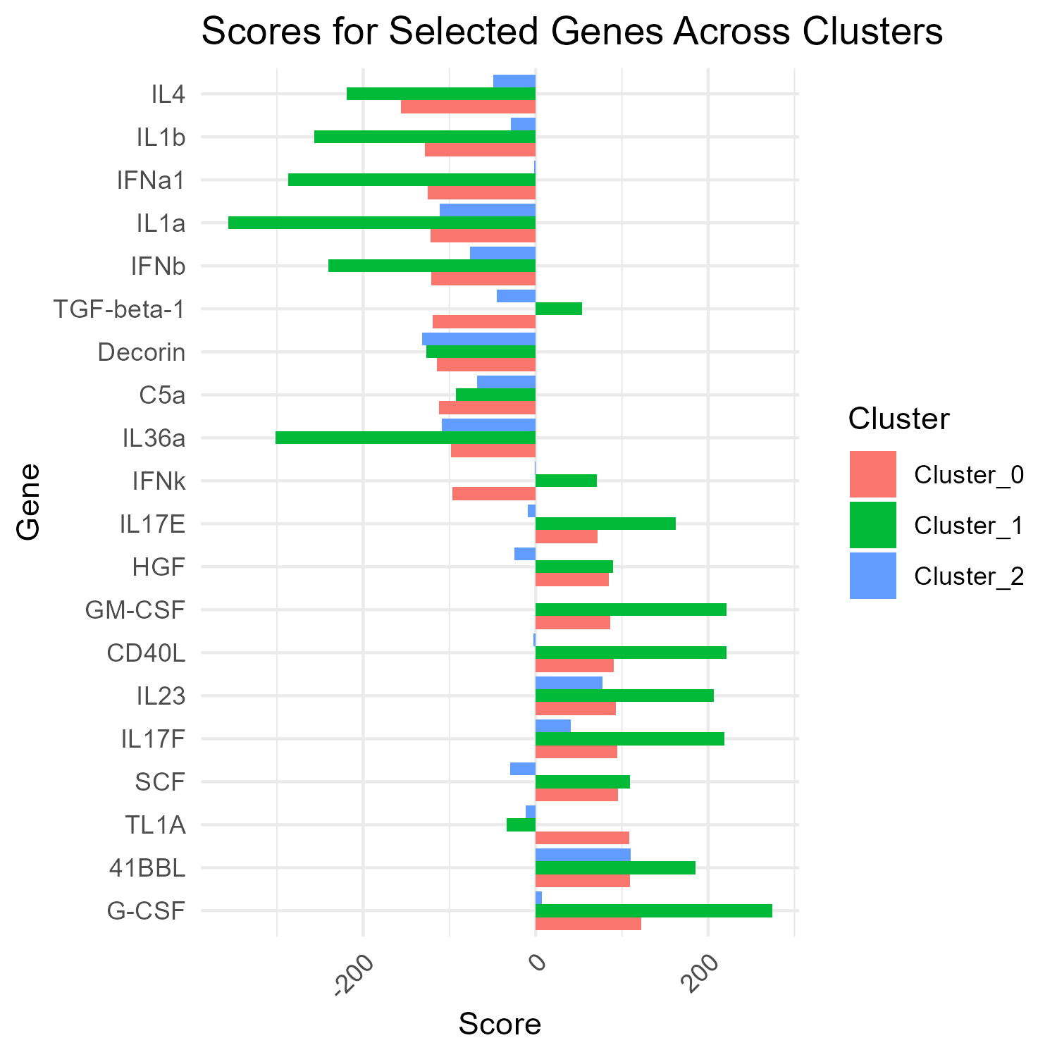
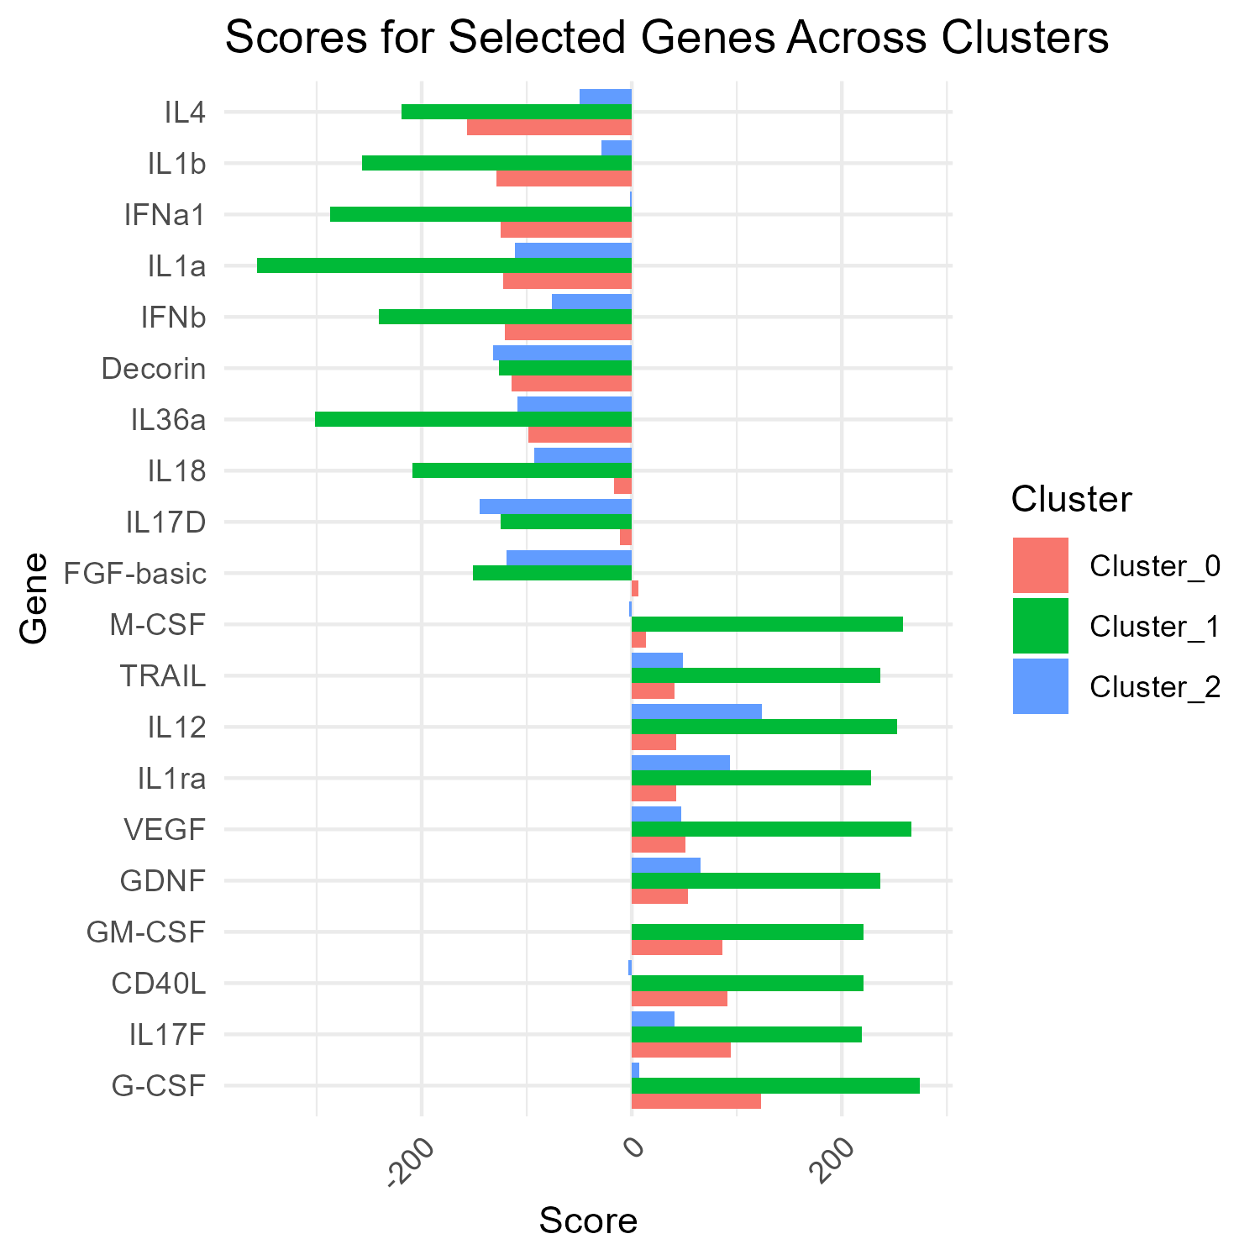
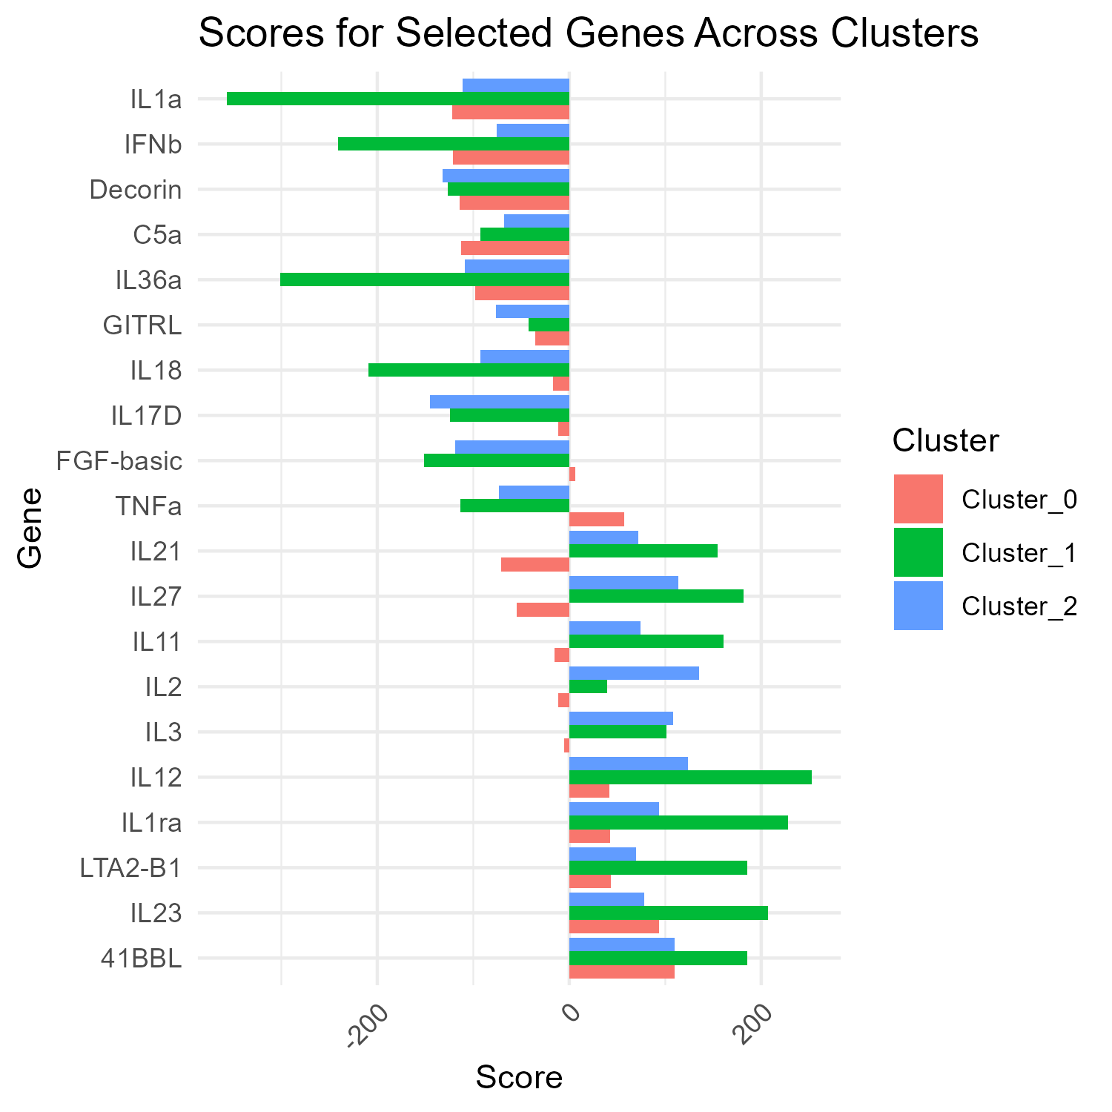
cytokine analysis
Cluster 0
Cluster 1
Cluster 2
Cui, A., Huang, T., Li, S. et al. Dictionary of immune responses to cytokines at single-cell resolution. Nature 625, 377–384 (2024). https://doi.org/10.1038/s41586-023-06816-9
Notes:
10 most felt and most unfelt cytokines in each cluster derived from DE genes
Cui, A., Huang, T., Li, S. et al. Dictionary of immune responses to cytokines at single-cell resolution. Nature 625, 377–384 (2024). https://doi.org/10.1038/s41586-023-06816-9

Slide 54
cytokine analysis
- il-2 high only in cluster 2, not in cluster 1 - CD40L high in both cluster 0 & 1. seemed like not responder trait, but cluster 1 seemed as responder cluster. maybe cluster 1 is less "responsive" than cluster 2 - some cytokines show linkage of cluster 0,1, and 2 is different. may tell some more about cluster identities

Slide 55
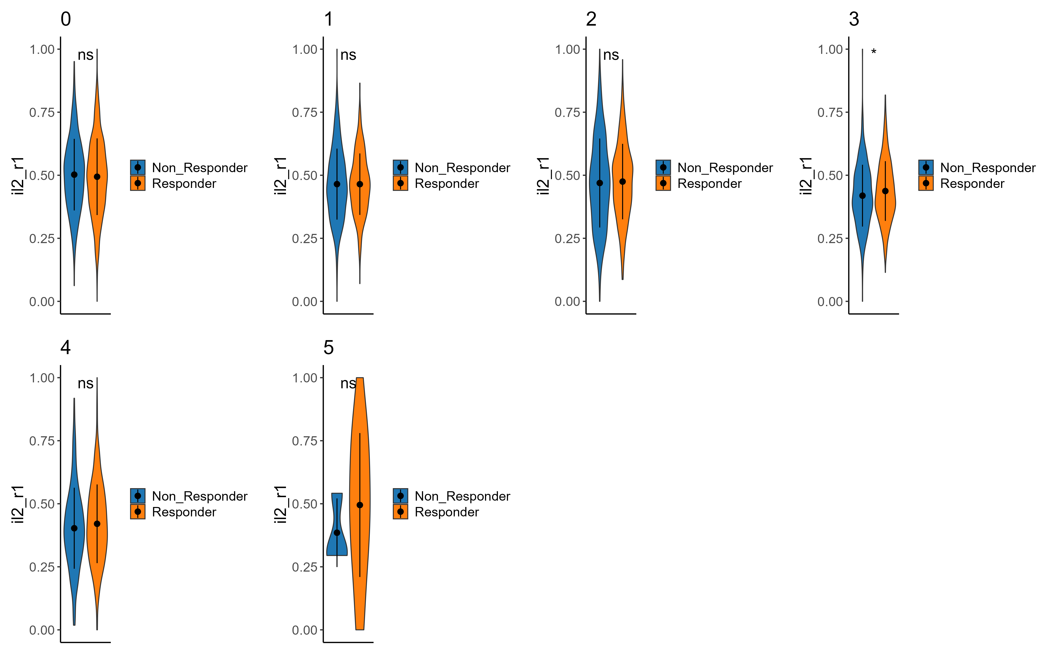
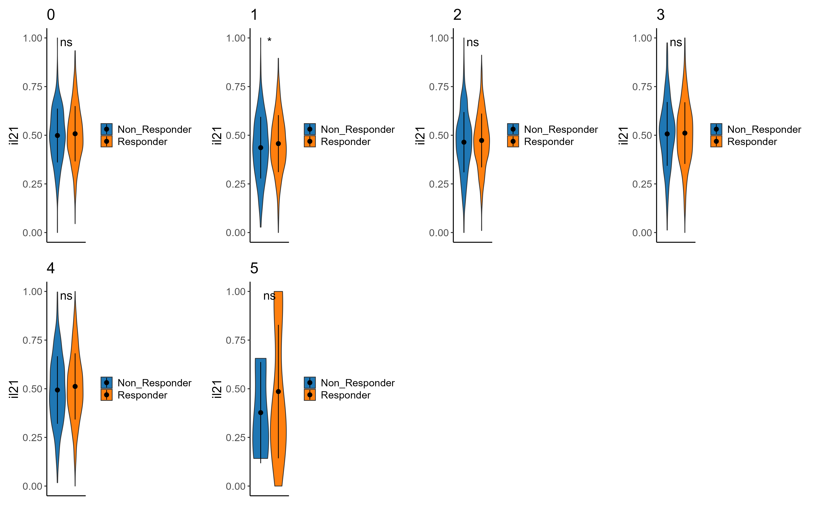
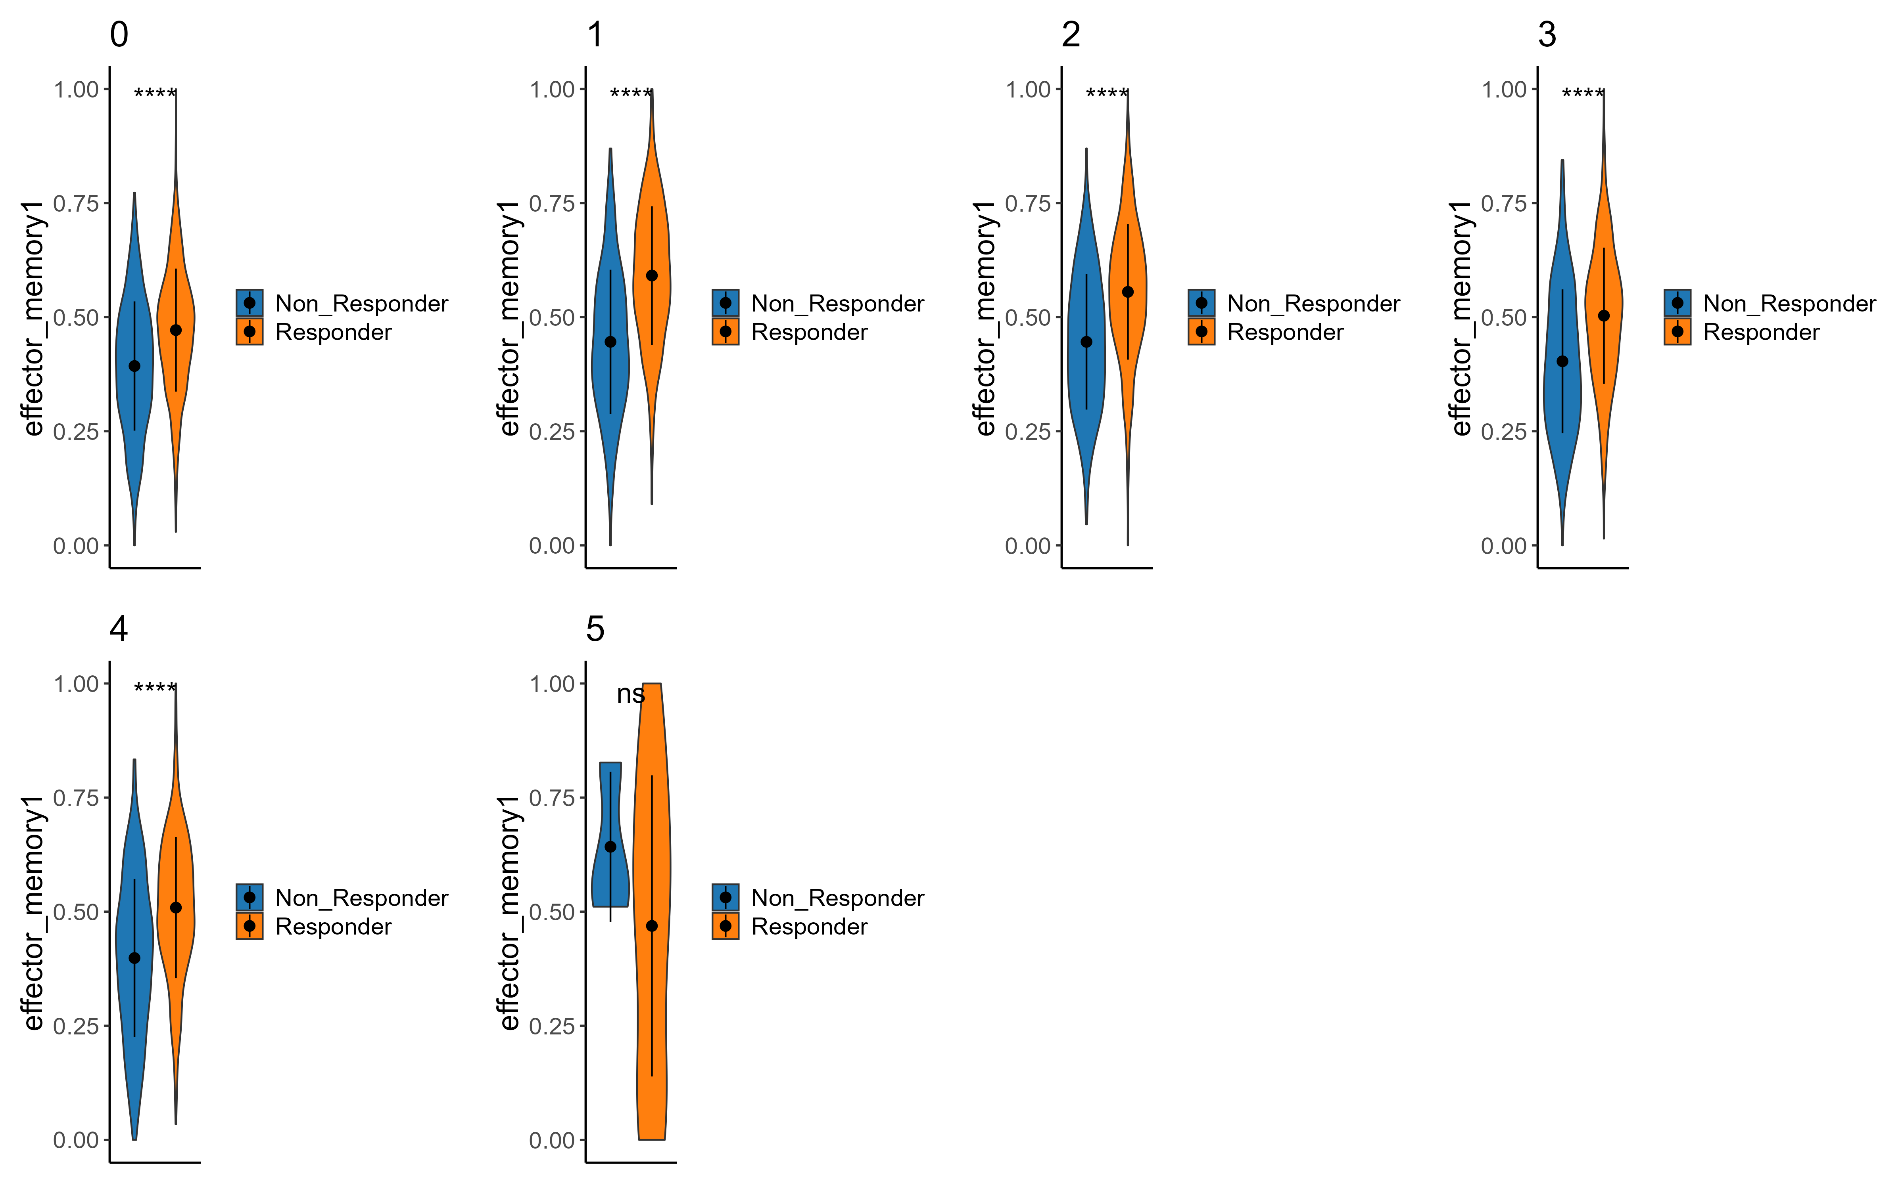
Signatures – cluster 1
il2
il2r
Effector memory

Slide 56
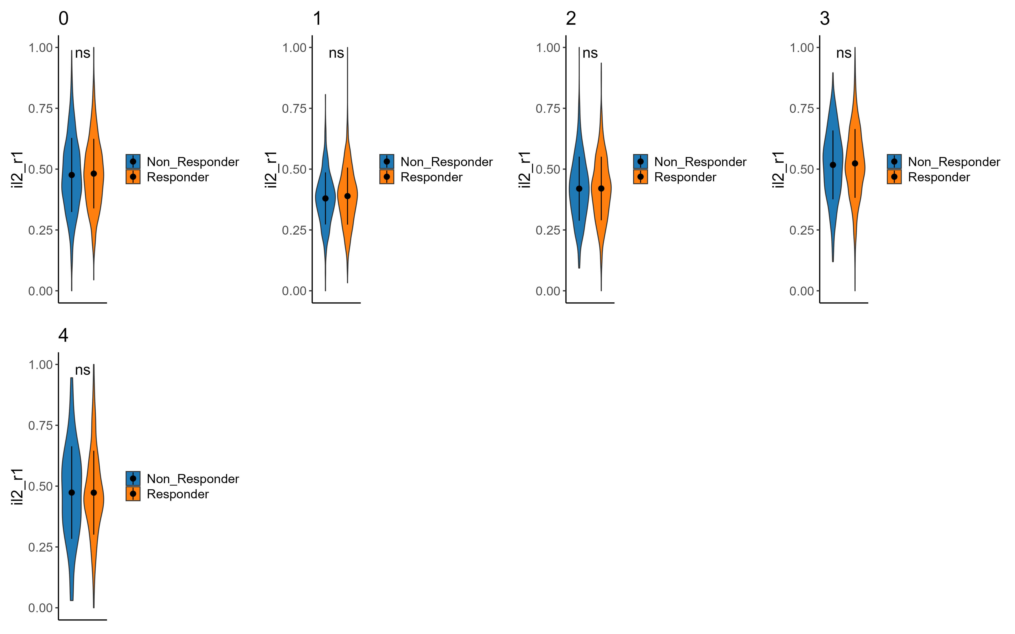
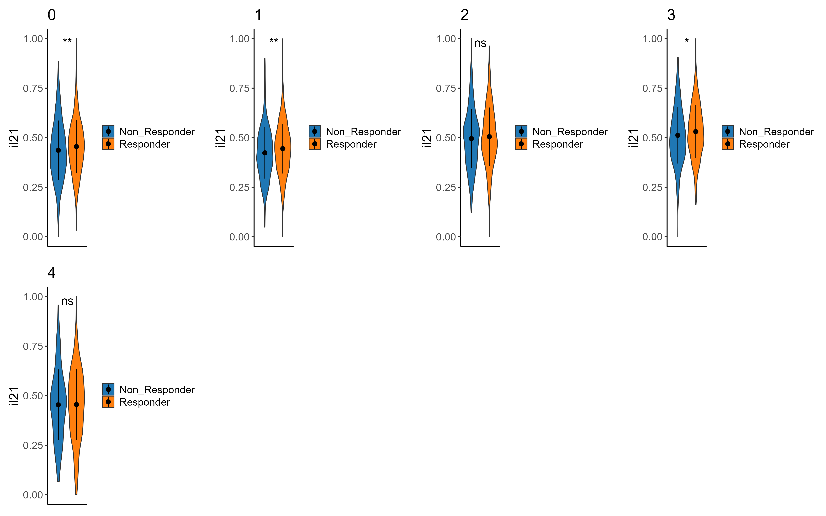



Signatures – cluster 2
il2r
il2
Effector memory
Persistance_upregulated
Cd8 memory

Slide 57
Signature summary
- il2 signature significant between responders & non in cluster 2 sub analysis, but not in cluster 1 - il2r not significant between responders & non in both clusters 1&2 - big difference in effector memory signature in both clusters
- cd8 memory & persistence signatures upregulated in responders vs non responders in cluster 2 much more than in cluster 1.

Slide 58




Signatures – cluster 0 - telomere length associated
downregulated signature
Upregulated signature
Notes:
Longer telomere = younger cell -> more persistance

Slide 59




Signatures – cluster 1 - telomere length associated
downregulated signature
Upregulated signature
Notes:
Longer telomere = younger cell -> more persistance

Slide 60




Signatures – cluster 2 - telomere length associated
downregulated signature
Upregulated signature
Notes:
Longer telomere = younger cell -> more persistance

Slide 61
Telomere signature summary
In cluster 0 we see higher expression of negatively correlated genes in responders than non-responders.
in clusters 1,2 we see lower expression of downregulated genes and higher expression of upregulated genes correlated with longer telomers.
Andreu-Sánchez, S., Aubert, G., Ripoll-Cladellas, A. et al. Genetic, parental and lifestyle factors influence telomere length. Commun Biol 5, 565 (2022).

Slide 62
פאנל פאקס ופאנל אלייזה(מה אנחנו הולכים לבדוק עכשיו)

Slide 63
Idea for development : JAK inhibition enhances checkpoint blockade immunotherapy
Jaroslav Zak et al. ,JAK inhibition enhances checkpoint blockade immunotherapy in patients with Hodgkin lymphoma.Science384,eade8520(2024).DOI:10.1126/science.ade8520

Slide 64
Observations - summary
ILR7 higher in responders (strongly aligns with literature) in cluster 0 only
Effector markers (GZMB, prf1, IFNG, GZMK, CD27) : higher in responders
effector/memory : KLF2 higher in responders
lower expression of ENTPD1 in responders both in CD8 & CD4 cells(exhausted-like).
CD40LG higher in non responders
N4 acts like responders in cluster 0, 1(a bit in 2 aswell) of all_cells(maybe interesting that he is not a responder ? )
- il2 signature significant between responders & non in cluster 2 sub analysis, but not in cluster 1 - il2r not significant between responders & non in both clusters 1&2
Longer telomers in responders in clusters 1,2 indicating naïve-like qualities.
DE between responders and non-respondesr in all_cells : SELL, CD27, GZMK, TRAV5
N4 acts like responders in cluster 0, 1(a bit in 2 aswell) of all_cells(maybe interesting that he is not a responder ? )
Notes:
(TIM3 and ENTPD1 mark the exhausted-like state of CD8+ T cells)

Slide 65
conclusions
upregulate effector marker
cd4\cd8 ratio ? persister cd4 traits ?

Slide 66
Next steps

Slide 67



The team Contact: asafmadi@tauex.tau.ac.il

Slide 68
extras

Slide 69

CD69

Slide 70
observations
general : - lower expression of ENTPD1 in responders (both in cd8 &cd4) (TIM3 and ENTPD1 mark the exhausted-like state of CD8+ T cells) https://www.ncbi.nlm.nih.gov/pmc/articles/PMC6641984/ - N4 acts like responders in cluster 0, 1(a bit in 2 aswell) of all_cells(maybe interesting that he is not a responder ? ) - il2 signature significant between responders & non in cluster 2 sub analysis, but not in cluster 1 - il2r not significant between responders & non in coth clusters 1&2 -

Slide 71
Observations - detailed
general : - lower expression of ENTPD1 in responders (both in cd8 &cd4) (TIM3 and ENTPD1 mark the exhausted-like state of CD8+ T cells) https://www.ncbi.nlm.nih.gov/pmc/articles/PMC6641984/ - N4 acts like responders in cluster 0, 1(a bit in 2 aswell) of all_cells(maybe interesting that he is not a responder ? ) - il2 signature significant between responders & non in cluster 2 sub analysis, but not in cluster 1 - il2r not significant between responders & non in coth clusters 1&2 - All_cells : - DE between responders and non-respondesr in all_cells : SELL, CD27, GZMK, TRAV5 - cluster0 + cd4 : - ILR7 higher in responders cluster 1 : - CD40LG higher in non responders. what is this? - klf2, bach2, CD27, higher in responders (?) cluster 2 : - cluster 0,2 (inside clus2 analysis) more non-responders - cluster 1,3 more responders - cluster 4 not significant - CD40LG, ENTPD1, : higher in nonresponders - GZMB, prf1, IFNG, GZMK, CD27, : higher in responders - activation\exhaustion : TIM3, TIGIT, TNF higher in respondesr - naive-like/memory : CD44, higher in responders - effector/memory : KLF2, higher in responders

